Slide 1
Name : Dr. Sanjib Pramanik
Name of the College : Durga College, Raipur (C.G.), India
Name of the Faculty : Arts
Designation : Assistant Professor, Department of Geography
Topic : APPLICATION OF REMOTE SENSING ON ENVIRONMENTAL STUDY
Date : 27/02/2024

Slide 2
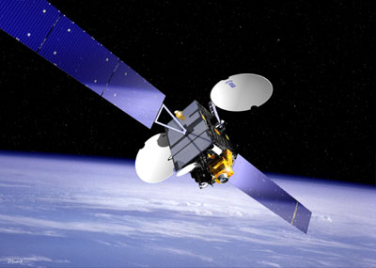
Remote Sensing
Remote sensing is an art or science of collecting data (information) from an object at a far distance without any physical contact.
REMOTE SENSING DATA:
Air Photo
Satellite Imagery
.

Slide 3
Component of Environment
Natural
cultural
Biological
Environment

Slide 4
Natural environment
Mount-ains
Seas
Tides
Insolation
soils
Wind
Minerals
Rivers

Slide 5
Biological Environment
Bacteria
Viruses
Plants
Animals
Parasites

Slide 6
Cultural environment
Polity
Economy
Society

Slide 7
Resolution
Spatial resolution : The details visible in an image is dependent on the spatial resolution of the sensor and refers to the size of the smallest possible features that can be detected. It is dependent on the instantaneous field of view (IFOV) of the sensor.
Spectral resolution : Spectral resolution describes the ability of a sensor to define fine wavelength intervals. The finer the spectral resolution , the narrower the wavelength ranges for a particular channel or band.

Slide 8
Radiometric resolution : While the arrangement of pixels describes the spatial structure of an image, the radiometric characteristics describe the actual information content in an image. The finer the radiometric resolution of a sensor, the more sensitive it is to detecting small difference in reflected of emitted energy.
Temporal resolution : Temporal resolution refers to the frequency of obtaining data over a given area . It is related to revisit period. The absolute Temporal resolution of a remote sensing system to image the exact same area at the same viewing angel a second time is equal to this period.

Slide 9
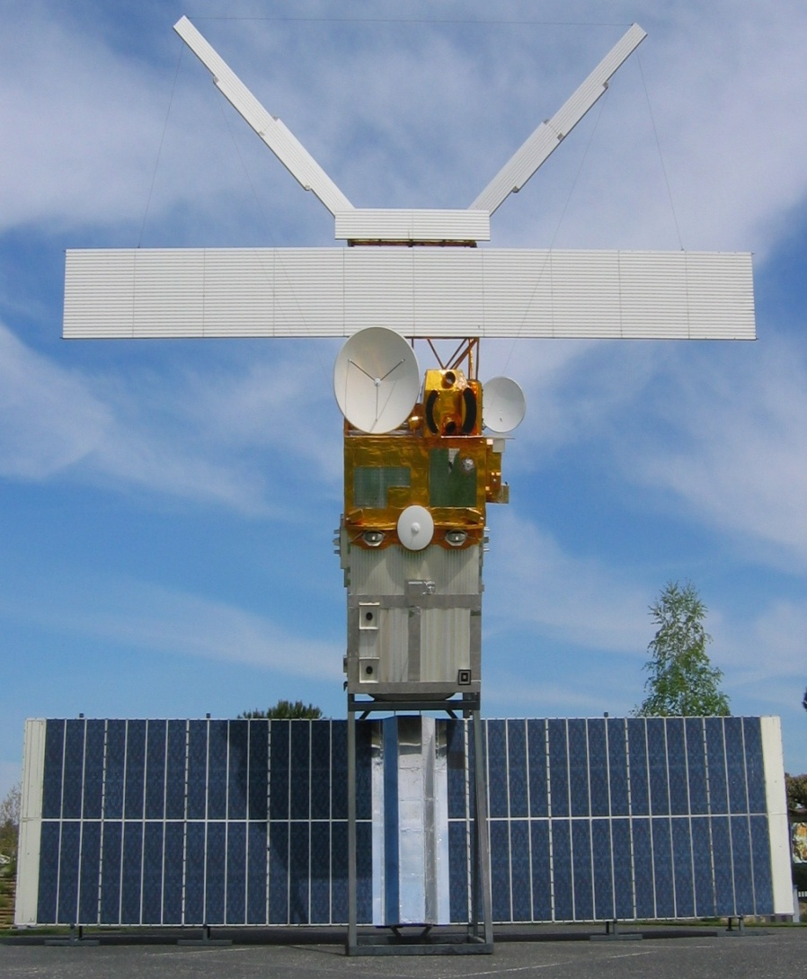
Environmental Satellite
GOES (GEOSTATIONARY OPERATIONAL ENVIRONMENTAL SATELLITE)
15 Satellites, 3 in operation
GOES 13
GOES 14
GOES 15
POLAR OPERATIONAL
ENVIRONMENTAL SATELLITES
10 Satellites 6 in operation.
NOAA-15
NOAA-16
NOAA-18
NOAA-19
METOP-B
METOP-A
A FULL SIZE MODEL OF AN EARTH OBSERVATION SATELLITE FROM ESA , ERS 2

Slide 10
INDIAN SPACE RESEARCH ORGANIZATION (ISRO)
Oceansat-2 23
IMS-1 28
Cartosat-2A
CARTOSAT-2
IRS P5 (CARTOSAT-1)
IRS P6 (Resourcesat 1)
IRS-P4 27
IRS-P3 21
IRS-P2 15
IRS P1
IRS-1D 29
IRS-1C 28
IRS-1B 29
IRS-1A 17

Slide 11
METEOSAT
Meteosat 5
Meteosat 6
Meteosat 7
Meteosat 8
Meteosat 9
WEATHER
TIROS-1
TIROS-2
TIROS-3
TIROS-4
TIROS-5
TIROS-6
TIROS-7
TIROS-8
TIROS-9
TIROS-10
RADARSAT series
RADARSAT-1
RADARSAT-2

Slide 12
MAJOR PROBLEMS OF ENVIRONMENT
Problem
Global warming
Deforestation
Increase disease
Economic Imbalance
Hazard
Pollution

Slide 13
Application Of Remote Sensing On Environmental Study
Natural Resource
Bio Diversity
Hazard And Disaster Management
Soil Moisture
Agricultural
Forestry
Water
Wildlife Habitat Mapping
Landscape Ecology
Crop Damage Assessment
Crop Type Mapping
Landslide
Flood

Slide 14
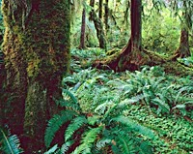
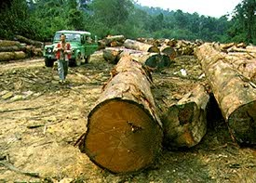
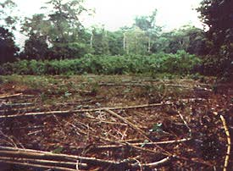
REMOTE SENSING APPLICATION ON FORESTRY
Wood
Deforestation

Slide 15
REMOTE SENSING APPLICATION FOR FORESTRY
Forest is an important global resources both commercial and non commercial forestry utilize a particularly diverse range of remote sensing application. Forestry application of remote sensing include following –
1. RECONNAISSANCE MAPPING
Forest cover type discrimination
Agro forestry mapping

Slide 16
2. COMMERCIAL FORESTRY
Forest inventory
Biomass estimation
Space
Burn delineation
Clear-cut mapping
3.ENVIROMENTAL MONITORING
Deforestation
Coastal protection
Watershed protection
Forest health

Slide 17
REMOTE SENSING DATA USED IN FOREST APPLICATION
Multitemporal data provides for change detector analysis .
High resolution data provide a detailed view of forest loss .
Clear-cut mapping and monitoring require regional scale images and or high resolution data .
Radar data differentiate mangrove from other land cover.
Thermal data used for detecting and mapping ongoing fire.
Multispectral data for observing stages of growth.
Satellite VNIR data for used for executing reconnaissance level forest surveys.

Slide 18
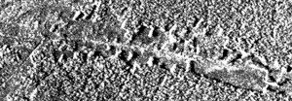
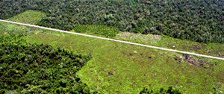
SATELLITE IMAGE OF DEFORESTATION
Comparison of an aerial photograph (bottom) with a radar image (top)
of deforestation along a road

Slide 19
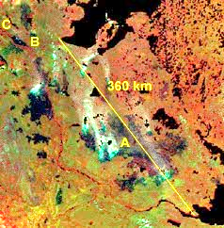
Detection of forest fires (Canada) NOAA-AVHRR image
A = Burned areas
B = Fort Norman
C = Norman Wells

Slide 20
Collection of satellite data
Selection of segments
Analysis of satellite data low and medium resolution
Forest information
Aggregation of state of zone wise data.
Generation of forest maps forest statistics.
Classification of forest area of definition of boundaries
Level III classification of forest area (tree species identification)
Fig: Flow chart of methodological adopted

Slide 21
APPLICATION OF REMOTE SENSING FOR WATER RESOURCE
There can be almost endless applications of the powerful remote sensing and geographic information technique to tackle problems related to land surface sea surface and atmospheric features and processes .
Remote sensing methods are adopted for the identification, investigation, planning and utilization of water resources

Slide 22
NEED FOR REMOTE SENSING IN WATER RESOURCE
To assess the water potential in the surface .
To assess the water quality .
Micro water shed planning .
Ground water potential .
National water plan development studies .
Surface water inventorying and surveying .

Slide 23
FOLLOWING ARE THE REMOTE SENSING DATA
USED IN WATER RESOURCE STUDY
IRS-1D Band 2&3.
Temporal data for seasonal variation at least three data in a year.
PAN data which give 3-D perspective of an area.
Radar data- for ground water potential .
IRS PAN -for micro water shed planning .

Slide 24
Acquisition of satellite data FCC print
at 1 : 250000
Preliminary interpretation of
enlarged images at 1 : 250000
Preparation of final hydrological map
Final interpretation
Ground check
Base map preparation
Collateral data
Fig: Flow chart of methodological adopted

Slide 25
APPLICATION OF REMOTE SENSING ON CROP TYPE MAPPING
It is one of the most important to identify and mapping of crops by remote sensing .
THIS SERVICE THE PURPOSE OF :
Forecasting grain supplies .
Factor influencing crop stress.
Assessment of damage crop due to storms and drought .
Remote sensing offered an efficient and reliable means of collecting the information in order to map crop type and acreage.
Remote sensing preceding a synoptic view which can provide structured information about the health of vegetation .

Slide 26
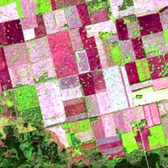
Satellite image of agricultural fields

Slide 27
CROP MONITORING AND DAMAGE ASSESSMENT
Early detection of crop disease
Prevention and cure
Crop health
Good agricultural productivity

Slide 28
APPLICATION OF REMOTE SENSING ON SOIL MOISTURE
Remote sensing offers a means of measuring soil moisture across a wide area instead of at discrete point locations that are inherent with ground measurement .
RADAR is effective for obtaining qualitative imagery and quantitative measurement .
RADAR back scatter response affected by soil moisture .
Multi temporal radar images show the change in soil moisture over time .

Slide 29
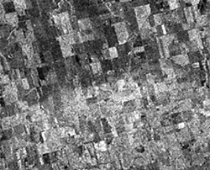
SOIL MOISTURE FROM RADAR IMAGE
Wet areas due to recent precipitation show up bright in the image (bottom half)

Slide 30
REMOTE SENSING APPLICATION ON FLOOD DELINEATION
AND MAPPING
Remote sensing are used to measure and monitor the extend of flood areas to efficiently target rescue efforts and to provide quantifiable estimates of the amount of land and infra structure affected Inco-operating remotely sensed data into a GIS allows for quick calculation and assessment of –
Water levels
Damage
Areas fusing potential flood danger
The identification and mapping of flood plains, abandoned river cannels and meanders are important for planning of transportation routing.

Slide 31
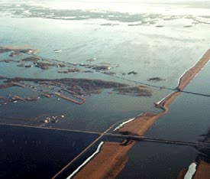
EXAMPLE OF FLOODING

Slide 32
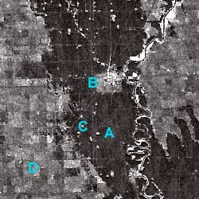
RADAR SATELLITE IMAGE OF FLOODING
A = Flooded area
(dark)
B = Town (bright)
C = Railroad
(bright line)
D = Farmland

Slide 33
REMOTE SENSING APPLICATION ON LANDSLIDE MAPPING
Satellite imagery has been used in the analysis of landslide occurrence primarily through the analysis of color composites.
Several studies have experimental with a use of true color composites.
In most cases the primary restriction has proven to be spatial resolution with only landslides of approx 50 m. X 50. m or larger being easily resolved.
Rather batter result were achieved using the 5.8 m. spatial resolution of IRS – 1 instrument.
False color composites (FCC) have used where scare landslide provides a clear change in the surface properties.
On the other hand used the LANDSAT thermal bonds to identify areas of permanently wet soil, which were linked with potential landslides.

Slide 34
REMOTE SENSING APPLICATION ON LANDSCAPE ECOLOGY
Remote sensing plays an important role in analysis of environmental ,cultural and natural resource management and its multi spectral capability present a perspective sensed data can be collected at multiple scale at multiple time ,therefore analysis of various phenomena on global scale drought time .
NEED:
Inventory and mapping of resource
Qualification of environmental characteristics .
Describing the flows of matter and energy of eco system and evolution changes and alternative solution for eco system management .
Identify community characteristics from a synoptic perspective, the ability to defect and observer temporal changes and habitat conditions .

Slide 35
REMOTE SENSING APPLICATION ON WILDLIFE HABITAT MAPPING
Remote sensing has great potential in wildlife management land cover food value and water resource are required for habitat ,the change of habitat due to –
Degradation due to reduction the canopy density .
Fragmentation over forest area .
Degradation due to fire .
Over grazing and cultivation .
NEED:
Monitoring the physical settings of protected area and land cover changes .
Monitoring of the corridors of the protected area, important population migration and genetic exchange .
Monitoring of positive and negative impacts on the habitat conditions .
Management and monitoring of various changes in the flora and fauna .

