Slide 1
BASICS OF
PSYCHOLOGY
Dr. Shakuntala Dulhani
Assistant Professor
Department of Psychology
Durga Mahavidyalaya Raipur

Slide 2
UNIT 1
What is Psychology?
B.A. Part 1

Slide 3

What is Psychology?
Psychology is the scientific study of mind and behaviour, according to the American Psychological Association.
Psychology is a multifaceted discipline and includes many sub-fields of study areas such as Human Development, Sports, Health, Clinical, Social Behaviour and Cognitive Processes.

Slide 4




Mental Processes are Cognitive Processes-
DREAM
PERCEPTION
THOUGHT
MEMORY

Slide 5


Psychologists also study emotions as they can also affect behaviour and cognition.

Slide 6
PSYCHOLOGY AS A SCIENCE
01
02
03
04
05
06
Make an observation.
Ask a question.
Form a hypothesis or testable explaination.
Make a prediction based on the hypothesis.
Test the prediction.
Iterate: Use the results to make new hypothesis or prediction.

Slide 7
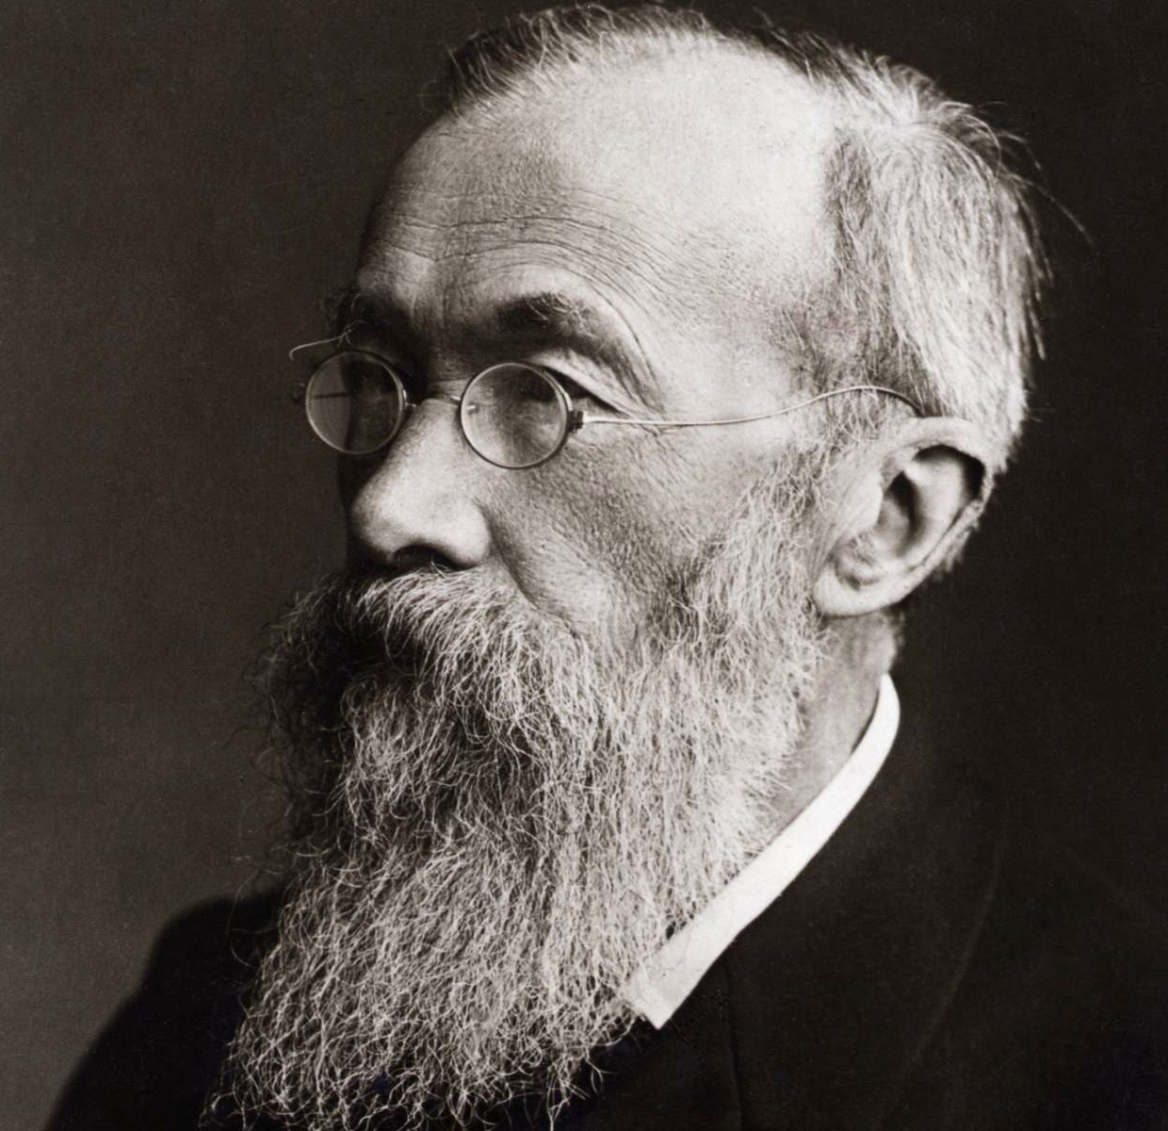
Psychology As A Science Of Social Behaviour
Wilhelm Wundt founded the first psychological study laboratory and is thought of as father of Psychology.
Psychology is a science because it uses the scientific method to examine human and social behaviour.

Slide 8

History Of Psychology

Slide 9
BEGINNING OF PSYCHOLOGY
Psychology evolved from Philosophy, Science, Medicine and Theology. Psychology evolved out of a coalescence of natural science and the branch of Philosophy known as Epistemology or the theory of knowledge.
In the beginning, Psychology was a 3-way synthesis of Physics, Physiology and Mental Philosophy.
The roots of Psychology goes back to Egypt and the Egyptian Mystery System.
Early Psychology focused on measuring and understanding the mind.
Later Psychology focused on measuring and understanding behaviour.

Slide 10
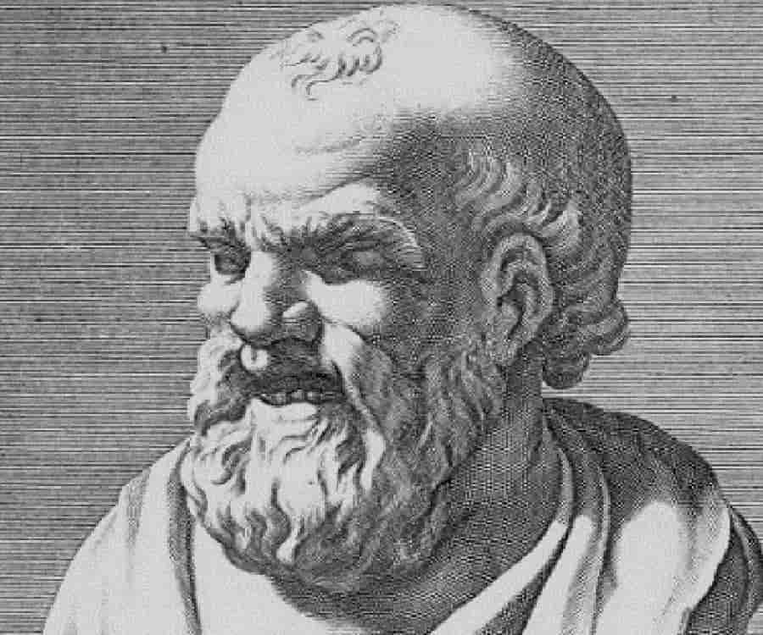

HISTORY OF PSYCHOLOGY
Democritus was a member of the school of thought called Atomism, a theory that held that the things of the physical world were made up of an infinite number of absolute units called Atoms. According to Democritus, being is as existent as non-being. Being is indivisible matter, the atom which cannot be split.
Plato – wrote The Republic. Duality of the Psyche. Plato was author of some 31 philosophical dialouges, and founder, in 387, of the Academy in Athens.

Slide 11
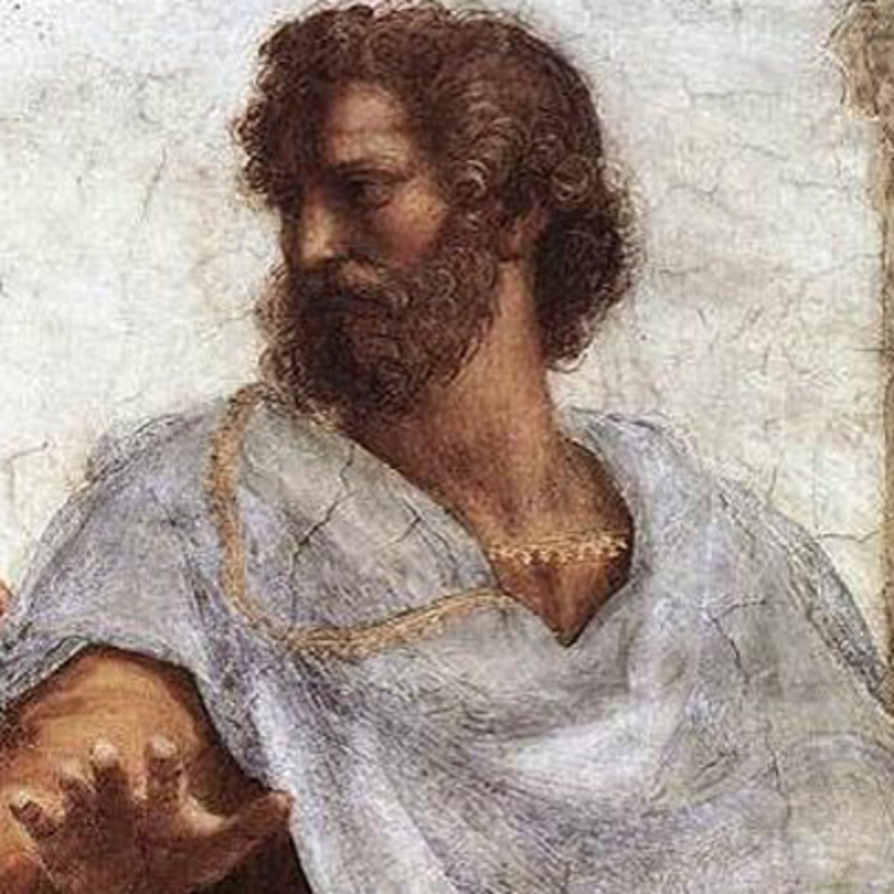
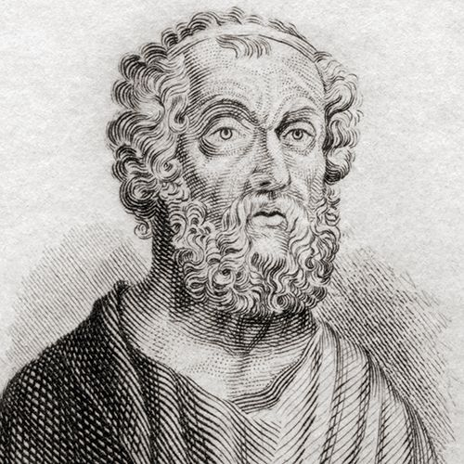
HISTORY OF PSYCHOLOGY
Aristotle was the greatest systematic philosopher of antiquity. He was the first to philosophise on the basis of science. Because of his great knowledge, especially in the physical sciences, he became known in history as a “Panepistimon”.
Homer (applied psychology). “Nothing is sweeter than home.” Is considered the greatest of the epic poets. Homer was a psycho-historian. Wrote to great epic masterpieces, the Iliad and the Odyssey.

Slide 12

Goals Of Psychology

Slide 13


1. DESCRIBE
The first goal of psychology is to describe the actual phenomenon in which humans and animals behave in different situations.
By describing a problem, an issue, or behavior, psychologists can distinguish between normal and abnormal behavior, allowing them to gain a better understanding and a more accurate perspective of human and animal behavior, thoughts, and actions.

Slide 14

2. EXPLAIN
Once a specific behavior has been described, psychologists then attempt to go beyond the obvious and explain why people act the way they do.
Through a series of rigorous tests, scientific experiments, and observations, psychology expounds on the reason behind someone’s actions.
Explaining behavior provides answers to why people behave the way they do under different circumstances.

Slide 15

3. PREDICT
Making predictions based on how people previously thought and acted is one of the primary goals of social psychology.
By analyzing past observed behavior, psychological studies aim to predict and anticipate how a certain behavior will appear again in the future.
This allows psychologists to form a pattern of behavior and better understand the underlying causes of people’s actions.

Slide 16

4. CONTROL
Aside from treating mental illnesses and enhancing well-being, changing or controlling human behavior is one of the primary goals of research in psychology.
Various psychological studies about human behavior are used to influence, change, or control behavior using previously gathered data about human behavior.

Slide 17
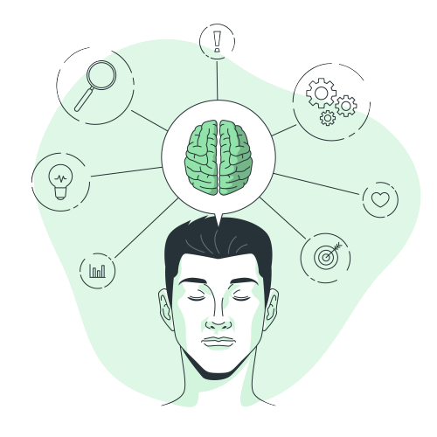
Perspectives
Of
Psychology

Slide 18


HUMANISTIC PERSPECTIVE
Humanistic Psychology is a psychological perspective that emphasizes the study of the whole person (know as holism).
Humanistic psychologists look at human behavior, not only through the eyes of the observer, but through the eyes of the person doing the behaving.

Slide 19
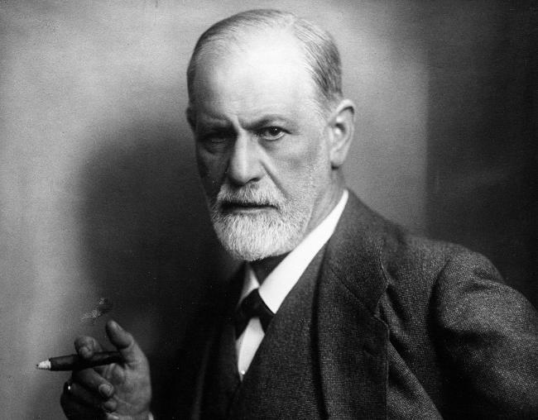
PSYCHODYNAMIC PERSPECTIVE
The psychodynamic perspective in psychology focuses on unconscious processes and unresolved conflicts that influence human behavior, emotions, and thoughts.
It emphasizes the role of early childhood experiences, unconscious desires, and the interplay of conscious and unconscious mental forces in shaping personality and behavior.

Slide 20

BEHAVIOURIST PERSPECTIVE
Behaviorism is different from most other approaches because they view people (and animals) as controlled by their environment and specifically that we are the result of what we have learned from our environment.

Slide 21
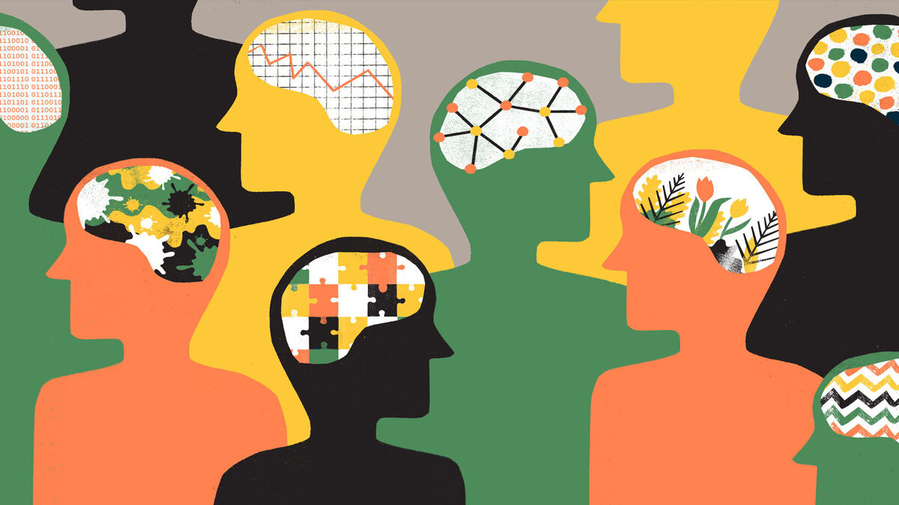
COGNITIVE PERSPECTIVE
The cognitive perspective in psychology explores how people think, perceive, and process information.
It's focused on understanding how individuals interpret and make sense of their experiences, leading to insights into learning, perception, and cognitive development.

Slide 22
THANK
YOU!

