Slide 1
Break, continue and goto statement in Programming in ‘C’ Lannguage
Dr. Vibha Dubey
Assistant Professor(H.O.D.)
Dept. Of Computer
Durga College(Raipur C.G.)

Slide 2
Break statement(break)
Sometimes it becomes necessary to come out of the loop even before loop condition becomes false then break statement is used. Break statement is used inside loop and switch statements. It cause immediate exit from that loop in which it appears and it is generally written with condition. It is written with the keyword as break. When break statement is encountered loop is terminated and control is transferred to the statement, immediately after loop or situation where we want to jump out of the loop instantly without waiting to get back to conditional state. When break is encountered inside any loop, control automatically passes to the first statement after the loop. This break statement is usually associated with if statement. Example

Slide 3
Example :
void main()
{
int j=0;
for(;j<6;j++)
if(j==4) break;
}
Output: 0 1 2 3

Slide 4
Continue statement (key word continue)
Continue statement is used for continuing next iteration of loop after skipping some statement of loop. When it encountered control automatically passes through the beginning of the loop. It is usually associated with the if statement. It is useful when we want to continue the program without executing any part of the program. The difference between break and continue is, when the break encountered loop is terminated and it transfer to the next statement and when continue is encounter control come back to the beginning position. In while and do while loop after continue statement control transfer to the test condition and then loop continue where as in, for loop after continue control transferred to the updating expression and condition is tested.

Slide 5
Example:
void main()
{
int n;
for(n=2; n<=9; n++)
{
if(n==4) continue;
printf(“%d”, n);
}
}
Printf(“out of loop”);
}
Output: 2 3 5 6 7 8 9 out of loop

Slide 6
goto statement in C
The goto statement is a jump statement which is sometimes also referred to as unconditional jump statement. The goto statement can be used to jump from anywhere to anywhere within a function.
Syntax:
Syntax1 | Syntax2
----------------------------
goto label; | label:
. | .
. | .
. | .
label: | goto label;
In the above syntax, the first line tells the compiler to go to or jump to the statement marked as a label. Here label is a user-defined identifier which indicates the target statement. The statement immediately followed after ‘label:’ is the destination statement. The ‘label:’ can also appear before the ‘goto label;’ statement in the above syntax.

Slide 7
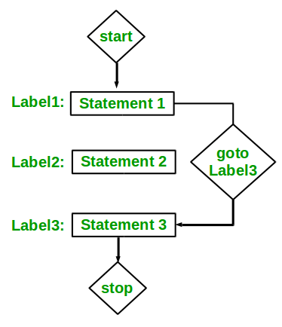
FLOW CHART

Slide 8
Example
#include <stdio.h>
int main ()
{
/* local variable definition */
int a = 10;
/* do loop execution */
LOOP:do
{
if( a == 15)
{
/* skip the iteration */
a = a + 1; goto LOOP;
}
printf("value of a: %d\n", a);
a++;
}while( a < 20 );
return 0;
}

Slide 9
THANK YOU

