Slide 1
Children at risk educationally
Presented by – kusum Rathore

Slide 2
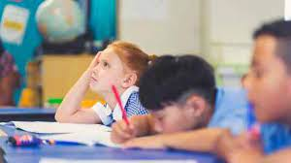
Caues :-
Tedious curriculam - Education is seen as a tedious & complex process as it involves molding people right from their childhood to adulthood .

Slide 3
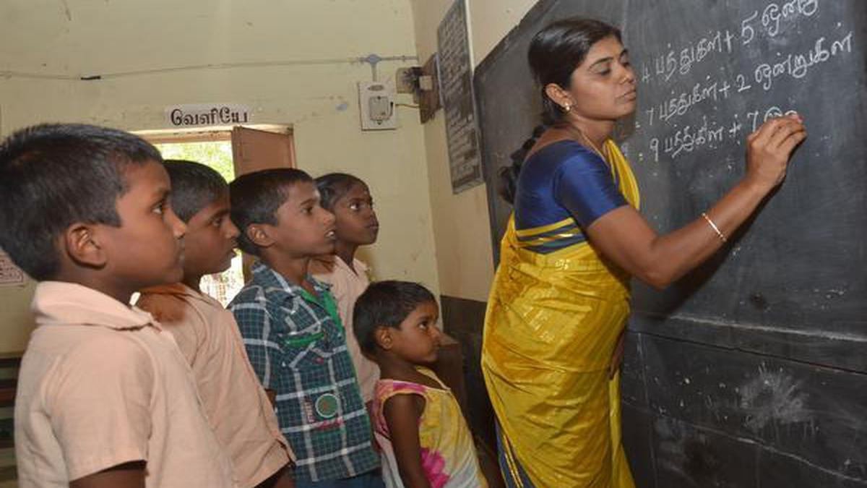
Untrained Teacher - Based on the Right of Children to Free and Compulsory Education Bill, passed in 2017, untrained teachers were given time to complete their teacher training. They needed to complete a Diploma in Elementary Education (D. El. Ed.) .

Slide 4
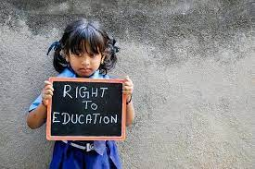
Lack of Teachers - children face considerable barriers to employment later in life. They are more likely to suffer adverse health outcomes and less likely to participate in decisions that affect them – threatening their ability to shape a better future for themselves and their societies.

Slide 5
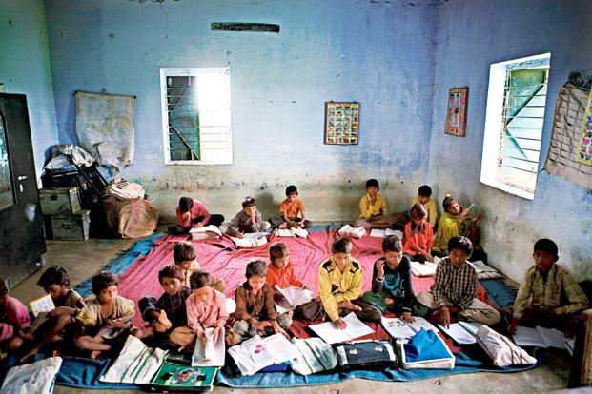
Lack of basic infrastructure - A lack of basic infrastructure can affect a student's learning ability when the physical conditions become uncomfortable or unsafe. There are You-tube video from over seas where students sit on the ground, have no proper school room and use sticks to write with

Slide 6
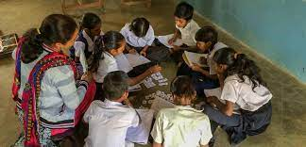
Low level of teaching - "Low level of education" generally refers to a person's educational attainment being at a level considered lower than what is typical for a certain context or society. The specific definition can vary depending on the region or the educational standards of a particular country

Slide 7

Not employment centred - Young people who are neither in employment nor in education or training are at risk of becoming socially excluded – individuals with income below the poverty-line and lacking the skills to improve their economic situation.

Slide 8
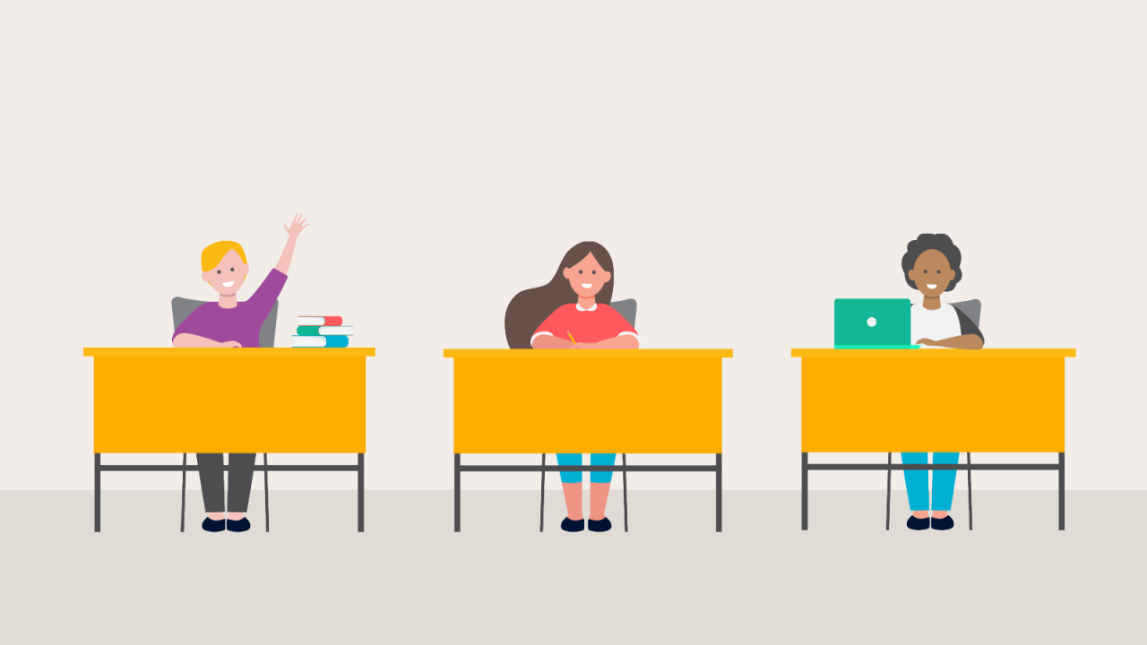
Wrong evaluation system - Extensive evaluation systems, particularly high-stakes exams, can generate excessive stress and pressure on students, System of education: Indian education system problems is heavily focused on rote learning, memorization, and theoretical knowledge

Slide 9
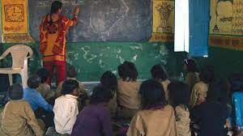
Lack of cordination - A lack of coordination in an organization can decrease productivity, complicate processes and delay the completion of tasks.

Slide 10

More distance between school and home - A distance between school and home greatly affect the student. It would be ultimately loss of studies of a student if his/ her school is far away from home. Moreover, they lack in study if their school is far from home. Having a huge distance between home to school affects the students in many ways.

Slide 11
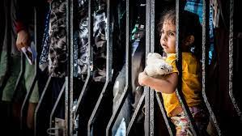
Lack of girls school - Barriers to girls' education – like poverty, child marriage and gender-based violence – vary among countries and communities. Poor families often favour boys when investing in education. In some places, schools do not meet the safety, hygiene or sanitation needs of girls.

Slide 12
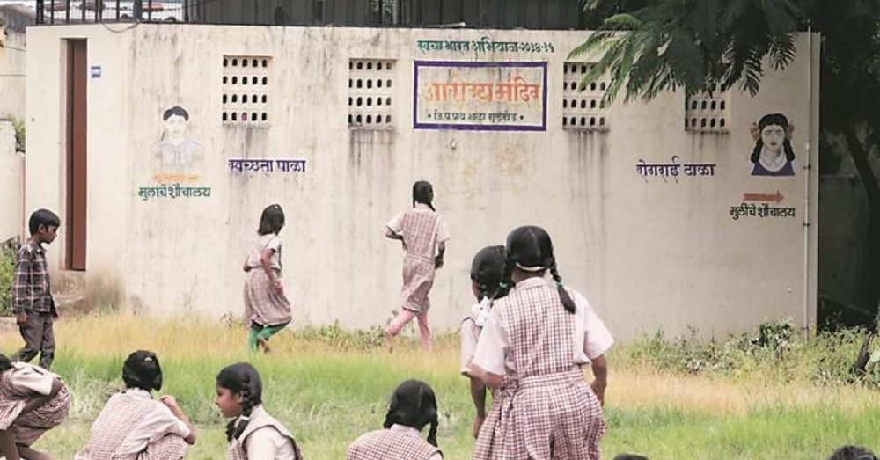
Lack of toilate - A lack of proper school toilets threatens the health, education and safety of at least 620 million children around the world, the charity WaterAid said in a new study today.

Slide 13
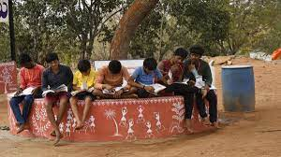
Lack of schools in remote areas - For the large majority of the population living in rural areas, education is highly dependent on government-run or aided schoolsIn India, the school in rural areas have only one or two teachers in the school

Slide 14
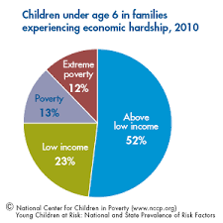
Low economic condition of families - Children from low-income families often do not receive the stimulation and do not learn the social skills required to prepare them for school. Typical problems are parental inconsistency (with regard to daily routines and parenting), frequent changes of primary caregivers, lack of supervision and poor role modelling.

Slide 15

Lack of awarness - With this rapid growth, there comes the challenge of lack of awareness in students. They know about the traditional courses but are not aware about the specialised courses, skill development courses or anything that will build new skills in us.

Slide 16
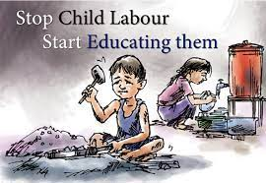
Due to child labour - The term “child labour” is often defined as work that deprives children of their childhood, their potential and their dignity, and that is harmful to physical and mental development

Slide 17
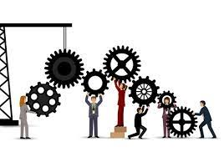
Lack of Policy execution - describes the various methods that may be used to invoke and run compliance policies can be validated against the network. It also describes the steps a user must take in order to execute the policies that have been created on the network.

Slide 18
Schemes applied by chhatisgarh
Free textbook scheme - State provides free textbooks to all students from class 1 to class 10th studying in Govt. as well as private schools.
Free Uniforms: All students from class 1 to class 8th studying in Govt.
Saraswati cycle scheme - launched in 2004-05 with an objective to promote girls enrolment and reduce the dropout of girl child in the age group of 14-18 at secondary and senior secondary level.

Slide 19
Student cycle scheme - The benefit of this scheme shall be available to all the regular students studying in school of School Education Department, and Scheduled Caste .

Slide 20
