Slide 1
Data Base Management System
Presented by
Dr. Monika patel
Asst professor
Computer dept
Durga college
Raipur (c.G.)

Slide 2
Database Management System (DBMS)
DBMS contains information about a particular enterprise
  Collection of interrelated data
  Set of programs to access the data
  An environment that is both convenient and efficient to use
Database Applications:
  Banking: transactions
  Airlines: reservations, schedules
  Universities: registration, grades
  Sales: customers, products, purchases
  Online retailers: order tracking, customized recommendations
  Manufacturing: production, inventory, orders, supply chain
  Human resources: employee records, salaries, tax deductions
Databases can be very large.
Databases touch all aspects of our lives
Notes:
2

Slide 3
University Database Example
Application program examples
  Add new students, instructors, and courses
  Register students for courses, and generate class rosters
  Assign grades to students, compute grade point averages (GPA) and generate transcripts
In the early days, database applications were built directly on top of file systems
Notes:
3

Slide 4
Drawbacks of using file systems to store data
Data redundancy and inconsistency
  Multiple file formats, duplication of information in different files
Difficulty in accessing data
  Need to write a new program to carry out each new task
Data isolation
  Multiple files and formats
Integrity problems
  Integrity constraints (e.g., account balance > 0) become “buried” in program code rather than being stated explicitly
  Hard to add new constraints or change existing ones
Notes:
4

Slide 5
Drawbacks of using file systems to store data (Cont.)
Atomicity of updates
  Failures may leave database in an inconsistent state with partial updates carried out
  Example: Transfer of funds from one account to another should either complete or not happen at all
Concurrent access by multiple users
  Concurrent access needed for performance
  Uncontrolled concurrent accesses can lead to inconsistencies
    Example: Two people reading a balance (say 100) and updating it by withdrawing money (say 50 each) at the same time
Security problems
  Hard to provide user access to some, but not all, data
Database systems offer solutions to all the above problems
Notes:
5

Slide 6
Levels of Abstraction
Physical level: describes how a record (e.g., instructor) is stored.
Logical level: describes data stored in database, and the relationships among the data.
  type instructor = record
  ID : string;
  name : string;
  dept_name : string;
  salary : integer;
        end;
View level: application programs hide details of data types. Views can also hide information (such as an employee’s salary) for security purposes.
Notes:
6

Slide 7
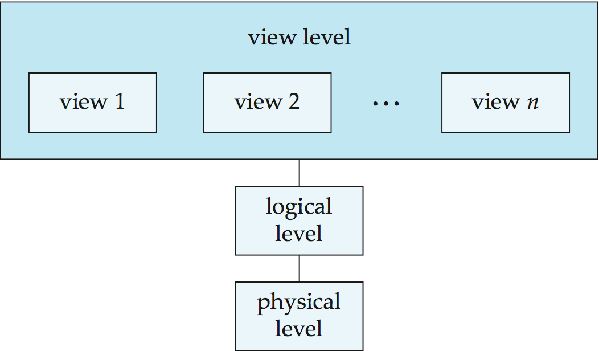
View of Data
An architecture for a database system
Notes:
7

Slide 8
Instances and Schemas
Similar to types and variables in programming languages
Logical Schema – the overall logical structure of the database
  Example: The database consists of information about a set of customers and accounts in a bank and the relationship between them
    Analogous to type information of a variable in a program
Physical schema– the overall physical structure of the database
Instance – the actual content of the database at a particular point in time
  Analogous to the value of a variable
Physical Data Independence – the ability to modify the physical schema without changing the logical schema
  Applications depend on the logical schema
  In general, the interfaces between the various levels and components should be well defined so that changes in some parts do not seriously influence others.
Notes:
8

Slide 9
Database Engine
Storage manager
Query processing
Transaction manager
Notes:
9

Slide 10
Storage Management
Storage manager is a program module that provides the interface between the low-level data stored in the database and the application programs and queries submitted to the system.
The storage manager is responsible to the following tasks:
  Interaction with the OS file manager
  Efficient storing, retrieving and updating of data
Issues:
  Storage access
  File organization
  Indexing and hashing
Notes:
10

Slide 11
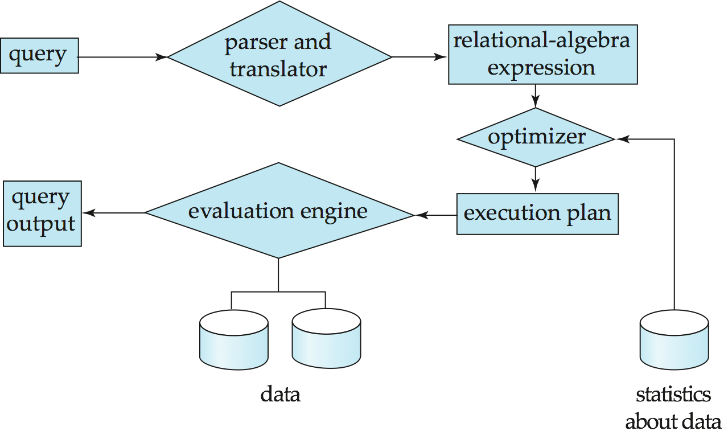
Query Processing
1. Parsing and translation
2. Optimization
3. Evaluation
Notes:
11

Slide 12
Query Processing (Cont.)
Alternative ways of evaluating a given query
  Equivalent expressions
  Different algorithms for each operation
Cost difference between a good and a bad way of evaluating a query can be enormous
Need to estimate the cost of operations
  Depends critically on statistical information about relations which the database must maintain
  Need to estimate statistics for intermediate results to compute cost of complex expressions
Notes:
12

Slide 13
Transaction Management
What if the system fails?
What if more than one user is concurrently updating the same data?
A transaction is a collection of operations that performs a single logical function in a database application
Transaction-management component ensures that the database remains in a consistent (correct) state despite system failures (e.g., power failures and operating system crashes) and transaction failures.
Concurrency-control manager controls the interaction among the concurrent transactions, to ensure the consistency of the database.
Notes:
13

Slide 14
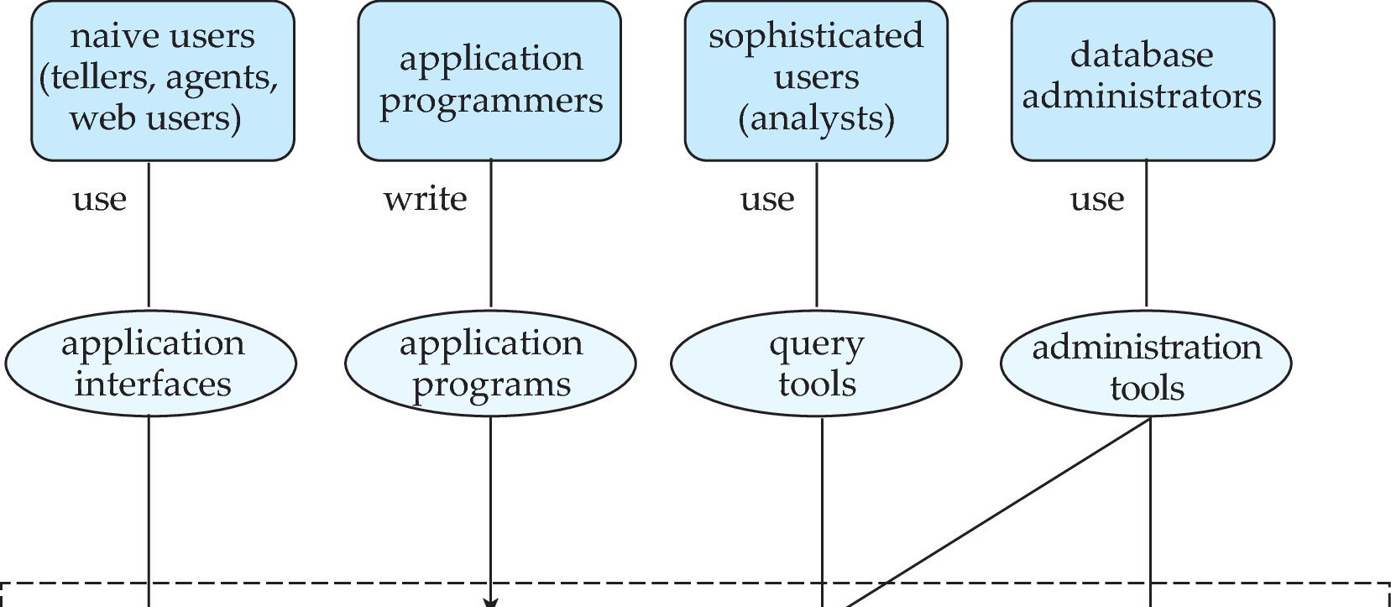
Database Users and Administrators
Database
Notes:
14

Slide 15
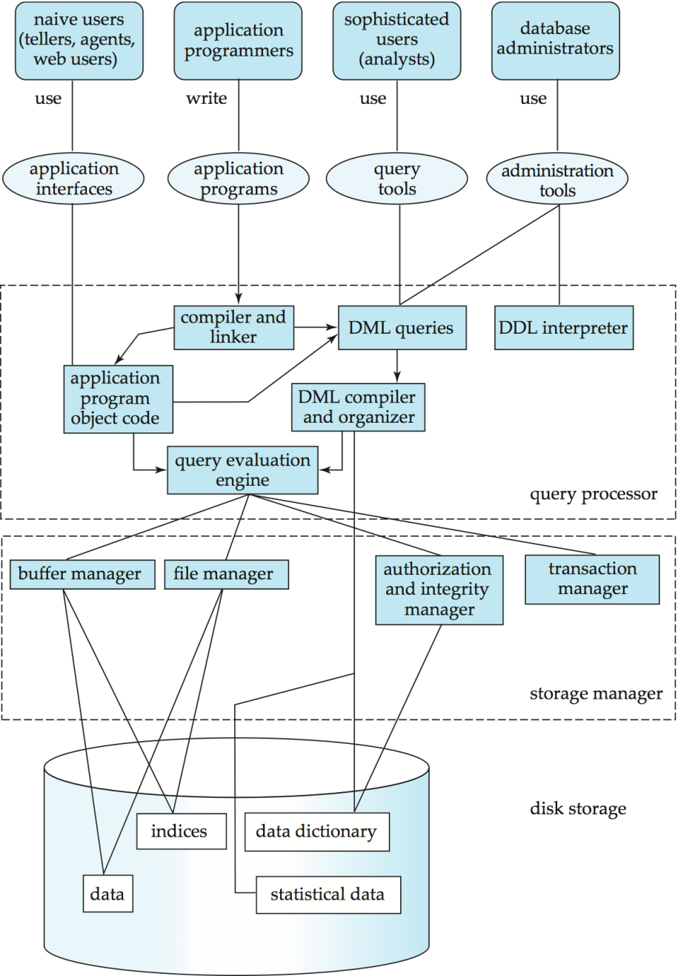
Database System Internals
Notes:
15

Slide 16
Database Architecture
The architecture of a database systems is greatly influenced by
the underlying computer system on which the database is running:
Centralized
Client-server
Parallel (multi-processor)
Distributed
Notes:
16

Slide 17
Thank You

