Slide 1
DEVELOPMENT
OF
MORALITY
Dr. Shankuntala Dulhani
Assistant Professor
Department Of Psychology
Durga Mahavidyalaya Raipur

Slide 2
B.A. PART 3
UNIT - 4
Development Of
MORALITY

Slide 3
What is Morality?
Morality is the belief that some behavior is right and acceptable to a society or group of people. Morality may also be specifically synonymous with “goodness” or “rightness”.

Slide 4
Aspects of Morality:-
Basically there are three aspects of morality
(1) Moral behavior:- Moral behavior are what one believes to be the right things to do. It involves caring , helping, sharing and volunteering . It can also be called as PROSOCIAL BEHAVIOR.
(2) Moral feeling:- Moral feeling would be only feeling that develops within a person to give one an idea of what is morally right and ethical.
(3)Moral judgement :- Moral judgements are evaluations or opinions formed as to whether some action or inaction intention, motive , character trait or a person as a whole is good or bad as measured against some standard of good.

Slide 5
What is Moral Devlopment?
Moral development focuses on the emergence , change and understanding of morality from infancy through adulthood. Morality develops across lifetime and is influenced by an individuals experience and their behavior when faced with normal issues through different periods physical and cognitive development.

Slide 6
Theories of Moral Development
(1) Freud’s concept of moral development in children
From Freud's theory of the id, the ego and the superego. Freud proposed the presence of tension between the society’s needs and the individuals.
(i) The id which is self preserving part of the mind only focuses on what feels good regardless of the consequences.
(ii) The superego on the other hand appears to be the moral centre which carefully considers actions before executing them based on what the environment dictates.
According to freud, once the child is able to repress his id and superego to function , the moral development ensues.

Slide 7
(2) Skinner’s concept of moral development
Based on the theory of behaviorism skinner also looks at how the child functions and how society or the environment affects it. He believes that socializing with other is a primary proponent of moral development
Skinner steers away from the idea of the tension between the internal and external environment but rather states that the outside world is what shapes the individuals internal sense of morality

Slide 8
(3) Piaget’s view on moral development of children
In Piaget’s theory of cognitive development, he looks at how intelligence emerges from childhood adulthood. His study also includes a look at how morality manifests in a child’s thoughts and behavior and the other factors that influence the development of concepts such as justice, welfare and rights.

Slide 9
(4) Kohlberg’s stages of moral development
Kohlberg’s theory of moral development states that we progress through three levels of moral thinking that build on our cognitive development . He used the idea of moral dilemma stories that present conflicting ideas about two moral values to teach 10 to 16 year old about morality and values.
After presenting people with various moral dilemmas, Kohlberg reviewed people’s responses and placed them in different stages of moral reasoning. Kohlberg identified three levels of moral reasoning under which there are 6 stages. Each level is associated with increasingly complex stages of moral development.

Slide 10
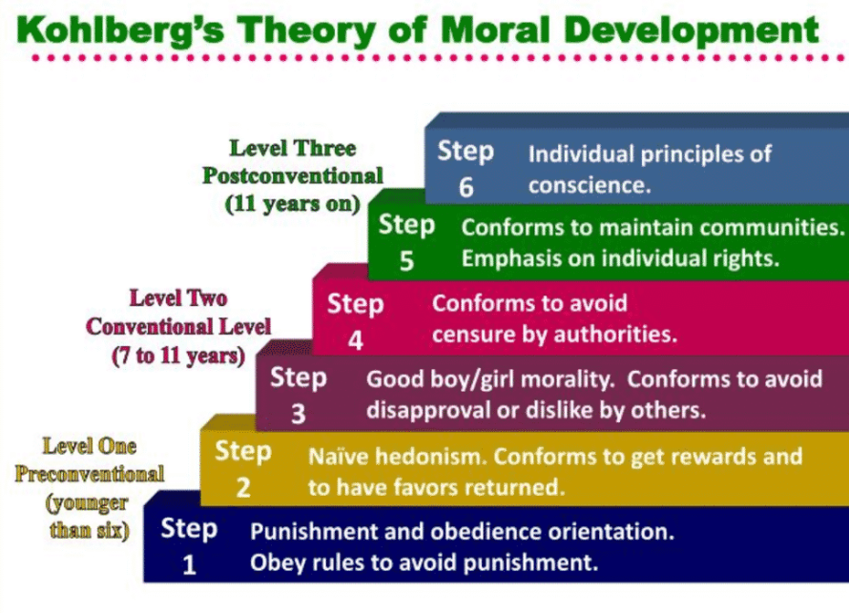

Slide 11
Factors Influencing Moral Development:-
(i) Family
(ii)School
(iii)Neighbourhood
(iv) Religious Institutions
(v) Club and camp experience
(vi)Playmates and Friends
(vii) Culture
(viii) Community

Slide 12
THANK YOU!

