Slide 1
DEVELOPMENT OF
GENDER DIFFERENCE
AND
GENDER ROLE
Dr. Shankuntala Dulhani
Assistant Professor
Department Of Psychology
Durga Mahavidyalaya Raipur

Slide 2
Development Of Gender Difference and Gender Role
Paper II (A)
B.A. PART 3

Slide 3
What is Gender?
The word sex describes the body. Sex organs and sex chromosomes show what sex someone is. The word ‘gender’ describes someone’s personality or character. It says if someone feels or acts more like a female (feminine) or more like male (masculine)

Slide 4
What is Gender Difference?
Gender differences are variance between males and females that are based on biological adaptation that are the same for both sexes. Gender differences are driven by differing environmental factors that affect our cognition and behavior.

Slide 5
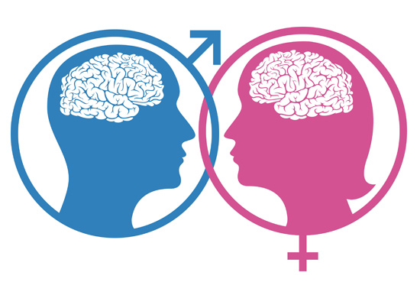
Differences between Males and Females
(1)Cognitive and Intellectual Achievement:- However male and females do not differ in general intelligence, but they do have difference in mathematics, verbal performance and spatial rotation skills and academic performance.

Slide 6
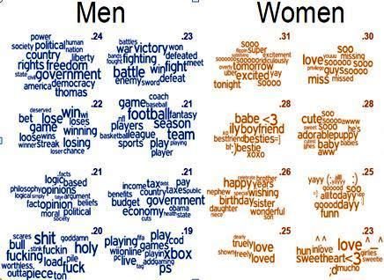
(2) Social and Personality difference:-
Few differences in personality arise between boys and girls. Some believe that boys are more physically active than girls. Boys are more rough and tumble players whereas girls seem to prefer smooth social interactions with each other.

Slide 7
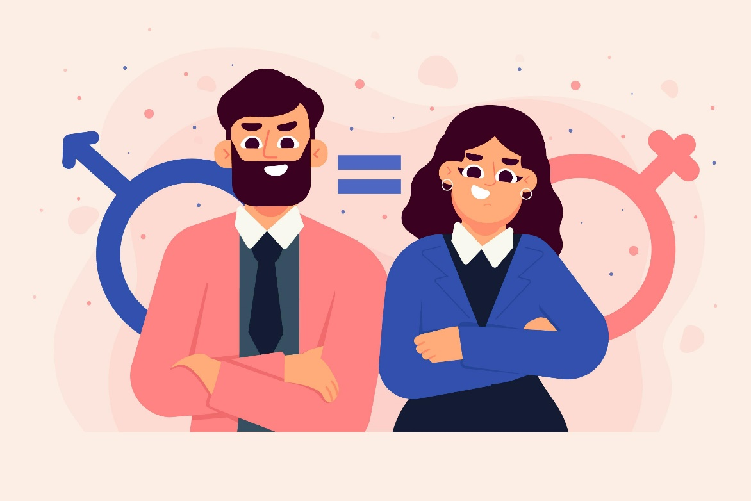
(3)Emotional differences:-
Females in comparison with their male counterparts may be more emotionally expressive, shameful, envious and helpless and experience and empress less anger and guilt.

Slide 8

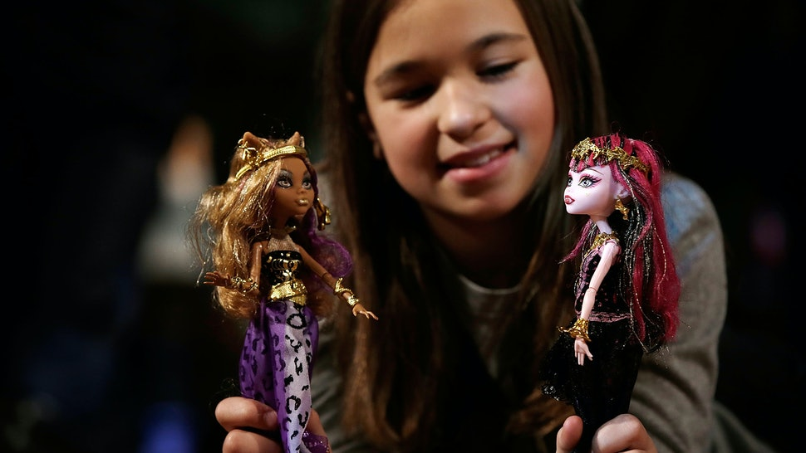
(4) Self esteem:-
Self esteem refers to highly an individual evaluates oneself . Males have slightly higher self esteem than females
(5) Preferences:-
There are different preferences of toys are seen in baby girls and boys. Girls like to play with dolls and kitchen sets where as boys like to play with trucks and constructive sets. Boys prefer to play more than girls

Slide 9
Gender Development Theories
(1)Biological Theories:-
According to biological theories psychological and behavioral gender differences between male and females. In this approach researchers have focused on historical explanation such as evolutionary processes and proximal explanations such as genes and sex hormones.

Slide 10
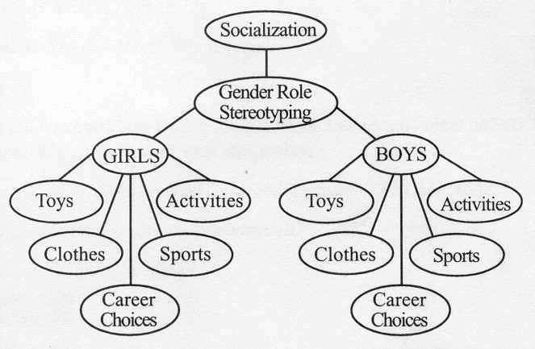
(2)Socialization Theory:-
Socialization theories of gender development view gender differences as by product of the differential treatment girls and boys receive from the people in their lives and the pervasive gender stereotyped messages that children are exposed to their environment.

Slide 11
(3)Cognitive Theory:-
Cognitive theories of gender development view children as active constructions of knowledge who seek, interpret and act on information in an effort to match their behavior to their understanding of gender.

Slide 12
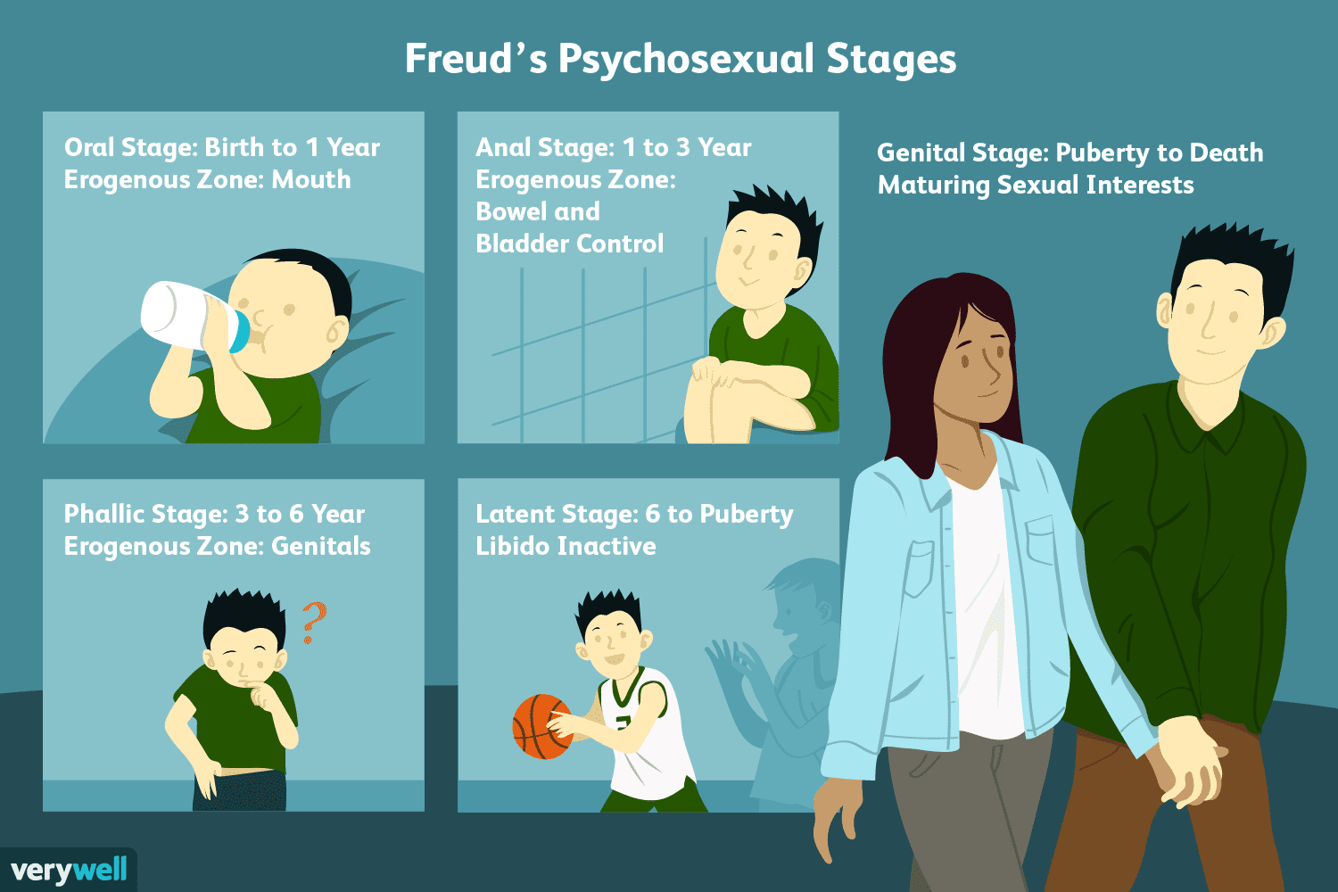
Major theories of gender role development:-
(I)Freud
(i)Ages 3 to 5 children feel sexually attracted to their other sex parent.
(ii)Ages 5 to 6 children feel guilty and anxiety over their attraction
(iii)Connection with same sex parent is crucial to long term mental health and sex derive.

Slide 13
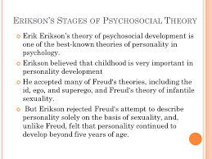
(II)Erikson:-
(i)An extension of freud’s theeory
(ii)Based on sexual differences between men and women to explain psychological differences
(iii)Due to differing genital structures males more intrusive and aggressive and female more inclusive and passive.

Slide 14
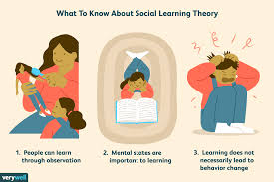
Social-Learning Theory
(1)Emphasis on the power of the immediate situation and observable behavior.
(2)Two ways children learn their gender roles
(i)receive rewards or punishments
(ii)watch and imitate the behavior og others
(3)Belief that children imitate the same sex parent
(4)Does not believe that child feel guilt or anxiety over a supposed attraction to the other sex parent.
(5)Socialization of children is one of the major causes of gender differences between boys and girls
(6)Children are encouraged to do the appropriate sex typed activities by the following
(i)parents
(ii)media
(iii)schools

Slide 15
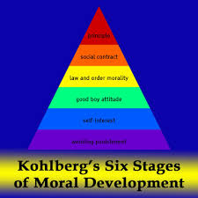
Cognitive Development Theory
(1)Children own cognitions are primarily responsible for gender development
(2)Kohlberg
(i)children identify with and imitate same sex parents and other of their same gender
(ii)after children label themselves as male and female the development of gender related interests and behavior quickly follow.

Slide 16
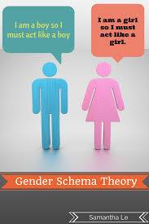
Gender-Schema Theory
(1)Theory suggests that children:
(i)Use gender as a schema to organise and guide their view of the world
(ii)Acquire gender specific behaviors through social learning
(iii)Own thought processes encourage gender development.
(2)A combination of the social-learning and cognitive development approaches all are humans our body have sexual desires and to share sexual intimacy we need a partner with whom we can share it .

Slide 17
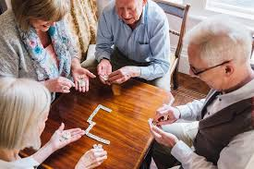
Social Need
Human a social animal he / she needs some one with whom he or she can share love, care, laughter, joy of lives. In life after some phases everyone leaves you at that point of time you need a partner to share your life with. Marriage provides the life long partner

Slide 18

Psychological Needs
Some of the psychological needs are certainty significance and love/ connection are essential for human survival. Need of life long love certainty and significance can only be fulfilled by the person who are close to you or basically care for you.

Slide 19
THANK
YOU!

