Slide 1
Durga mahavidyalay Raipur
Department of Commerce
Assistant professor dR.Vaseemuddin
B.Com. first year
Business environment
Topic- unemployment

Slide 2
Unemployment:
Types
Calculating Rates
Implications

Slide 3
Types of unemployment
Frictional Unemployment: When people take time to find a job.
  Example: When someone is laid off, changes jobs, or need time to find a job after graduating from school.

Slide 4
Types of unemployment
Structural Unemployment: When workers’ skills do not match what jobs are available for (structure of) the current economy.
Causes of Structural Unemployment:
  New Technology
  New Resources
  Changes in Consumer Demand
  Globalization- Shift to foreign markets
  Lack of Education

Slide 5
Types of unemployment
Seasonal Unemployment: When industries slow or shut down for a season of the year to make seasonal shifts in production schedules and people lose their jobs.
  Examples: When people who sell Halloween costumes or Christmas trees are out of a job because the holiday has passed.

Slide 6
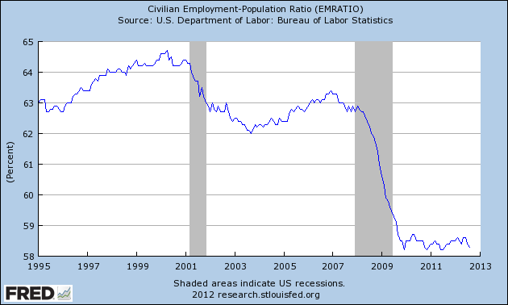
Types of unemployment
Cyclical Unemployment: Unemployment that goes up during times of economic turmoil, and goes down during times of economic prosperity.
  Examples: A recession causes people to save more and spend less, because of this companies may slow down production and lay off workers.

Slide 7
The unemployment rate
The rate of unemployment is a great way to measure the health of your economy.
The Unemployment Rate is the percentage of a nation’s labor force that is unemployed.
The Labor Force is NOT every citizen.
The Labor Force is made up of individuals 16 and older who either have a job or are actively seeking for a job.
The Unemployment Rate is adjusted to account for seasonal unemployment so that it is more accurately reflective of the health of the economy.

Slide 8

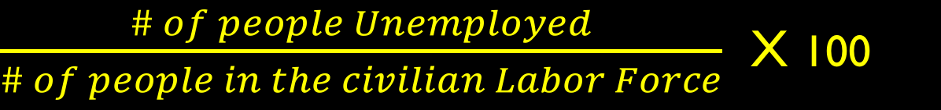
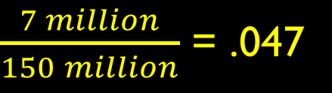
Calculating the unemployment rate
To find the Unemployment Rate, we use the following equation:
For Example, if there are 7 million unemployed people. And there are 150 million people in the civilian labor force, we have the following rate of Unemployment:

Slide 9
Goal: Full employment
Zero Unemployment is always impossible in a market economy.
But we strive for Full Employment where no cyclical unemployment exists in the economy.
An unemployment rate of about 4-6 percent is normal during full employment.

Slide 10

Aspects of full employment
Full Employment means everyone who wants a job has a job.
But some of those people may be Underemployed meaning they are working at a job below their skillset.
  Example: An individual with a Master’s degree, unable to find work in their field, and settling for a job at Publix.

Slide 11
Aspects of full employment
Additionally, some people give up trying to find work, especially during a long recession.
When people stop looking for jobs and rely on other means to sustain themselves, they are considered a Discouraged Worker.
These people are NOT actively seeking a job and are therefore not included in the Unemployment Rate.
If Underemployed and Discourage Workers were included in the Unemployment Rate, it would be much higher.

Slide 12
Thank You

