Slide 1
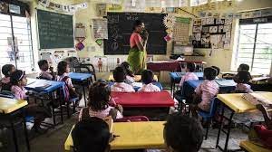
EDUCATION IN THE NON –VIOLENT SCHOOL /CLASSROOM ENVIORMENT
Dr. Sanjivani Thakur
Assistant Proffesor
Dept. of Education
Durga Mahavidhyalaya, Raipur (C.G.)

Slide 2
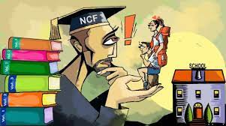
In the NCF, 2005 many things have been said in detail about non violence " peace education must be a concern that permeates the entire school life - curriculum , co - curriculum , classroom environment, School management, teacher- pupil relationship , teaching - learning processes , and the entire range of school activity".

Slide 3

1. Use of child Centre teaching method- Teacher should use child Centre teaching method for nonviolent environment.

Slide 4

2. Importance to Child Psychology - every teacher should have knowledge of Child Psychology and use the principle of Child Psychology during classroom teaching.

Slide 5
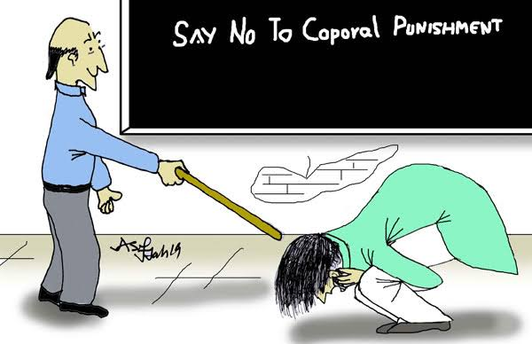
3. Opposition of all type of punishment - All form of physical and mental violence should be opposed in school. The effect of violence became permanent on the unconscious mind of children.

Slide 6

4. Appointment of deserving virturous teacher - teachers play the important role in influencing school violence. The importance of non violence should be explained by the teachers.

Slide 7

5. Establishment of peace clubs and libraries - According to NCF 2005" set up special clubs and reading room in school that concentrate on peace news and events that violence the norms of social justice and equality .

Slide 8

6. Searching of non violent movies - According to NCF 2005 - " compile list of films - documentaries and feature , films that promote the values of justice and peace. screen them frm time in schools."

Slide 9

7. Use of media - The NCF 2005 explicitly states that " co- opt the media as a stakeholder in education for peace . The media partners to stop violence , non - violence related programs should be broadcast in the media.
Notes:
BY-NEHA KAMDE

Slide 10


