Slide 1
Entity-Relationship Model
Diagrams
Presented By
Dr. Monika Patel
Asst. Professor Computer Dept
Durga Mahavidyalaya Raipur(CG)

Slide 2
Purpose of E/R Model
The E/R model allows us to sketch the design of a database informally.
Designs are pictures called entity-relationship diagrams.
Fairly mechanical ways to convert E/R diagrams to real implementations like relational databases exist.

Slide 3
Entity Sets
Entity = “thing” or object.
Entity set = collection of similar entities.
  Similar to a class in object-oriented languages.
Attribute = property of an entity set.
Key Attributes
  There are some attributes, which are having special characteristic to identify the Entity sets.
  Generally, all entities in a set have the same properties.
  Attributes are simple values, e.g. integers or character strings.

Slide 4
Key
A super key is any set of attributes which can uniquely identify an entity.
A key is a minimal set of attributes whose values uniquely identify an entity in the set.
There could be more than one candidate key.
  A key is also called a candidate key.
A primary key is a candidate key chosen to serve as the key for the entity set.

Slide 5
Concept of Keys
A super key of an entity set is a set of one or more attributes whose values uniquely determine each entity.
Ex. Super key : ( customer-id, Customer-name)
A candidate key of an entity set is a minimal super key
  Customer-id is candidate key of customer
  account-number is candidate key of account
Although several candidate keys may exist, one of the candidate keys is selected to be the primary key.
The combination of primary keys of the participating entity sets forms a super key of a relationship set.
  (customer-id, account-number) is the super key of depositor
  NOTE: this means a pair of entity sets can have at most one relationship in a particular relationship set.
    E.g. if we wish to track all access-dates to each account by each customer, we cannot assume a relationship for each access. We can use a multivalued attribute though

Slide 6
Entity-Relationship diagram
(E-R diagram)
The E-R model can be presented graphically by an E-R diagram.
age
address
phone
name
Employee
attribute
entity

Slide 7
A key may contain more than one attribute.
For example, {location,date,time} is a key.
{lecturer, date, time} is also a key.
{lecturer, location, data, time} is not a key, but it is a superkey.
location
lecturer = Chan Tai Man
date
course code = CSC3170
course-code
C1
location = HSB 508
time
lecturer
date = 9 Jan 2003
Course
time = 9:30am

Slide 8
The key should depend on the real life possibility rather than on the current set of the data.
For example, in the previous database which contains only two employees, the age can distinguish each employee. However, we may get a new employee with the same age as an existing employee.

Slide 9
Usually, we need to add an extra attribute as a key.
employee 1
ID
name = Chan Tai Man
age
address = 25, Siu Road, Shatin
address
ID = A234980
phone
name
age = 55
Employee
phone = 1234-5667

Slide 10
Weak Entities
Strong entity
  An entity which has a super key.
  Each entity can be distinguished from other entities in the same set.
Weak entity
  Without super key.
  May not be able to distinguish themselves from others without associations with entities in other entity sets.

Slide 11
Relational Model
Attributes
Example of tabular data in the relational model
Customer-id
customer-
name
customer-
street
customer-
city
account-
number
192-83-7465
019-28-3746
192-83-7465
321-12-3123
019-28-3746
Johnson
Smith
Johnson
Jones
Smith
Alma
North
Alma
Main
North
Palo Alto
Rye
Palo Alto
Harrison
Rye
A-101
A-215
A-201
A-217
A-201

Slide 12
E/R Diagrams
In an entity-relationship diagram, each entity set is represented by a rectangle.
Each attribute of an entity set is represented by an oval, with a line to the rectangle representing its entity set.

Slide 13
ER diagram
Juice Bars / Restaurants
There is a scenario of Juice bar selling some juice/drinks. The Juice bar is characterized by name , address and license. The bar sells some fresh or branded juices/drinks. Depending on their liking drinkers frequently visits Bar and are characterized by their names and addresses.

Slide 14
Example
name
manf
Entity set Drinks has two attributes, name and manf (manufacturer).
Each Drinks entity has values for these two attributes, e.g. (Bud, john-Busch)
Drinks

Slide 15
Relationships
A relationship connects two or more entity sets.
It is represented by a diamond, with lines to each of the entity sets involved.

Slide 16
Example
name
addr
name
manf
Juice
Bars
Sells
Drinks
Juice Bars
sell some
drinks.
license
Drinkers like
some drinkers.
Frequents
Likes
Note:
license =
beer, full,
none
Drinkers frequent
some bars.
Drinkers
name
addr

Slide 17
Relationship Set
The current “value” of an entity set is the set of entities that belong to it.
  Example: the set of all bars in our database.
The “value” of a relationship is a set of lists of currently related entities, one from each of the related entity sets.

Slide 18
Example
For the relationship Sells, we might have a relationship set like:
Bar Drinks
Joe’s Bar Bud
Joe’s Bar Miller
Sue’s Bar Bud
Sue’s Bar Pete’s Ale
Sue’s Bar Bud Lite

Slide 19
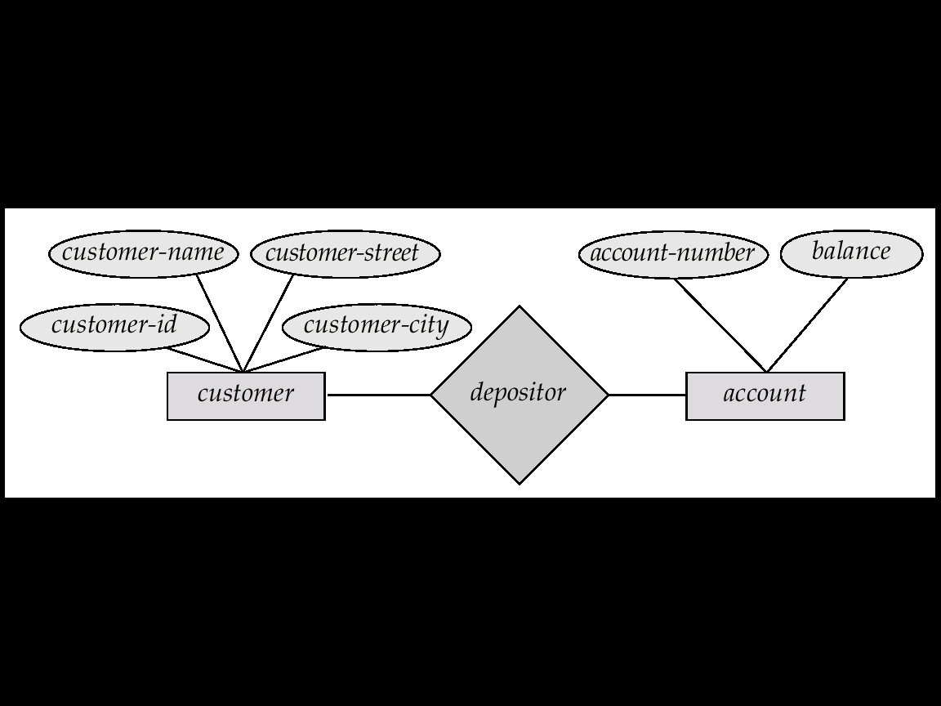
ER Models
Another Example of a Bank
In a bank each customer is “Entity”
and bank account can be considered to be Entity, which are described by attributes.
Here Attributes are account -number and balance, describing one particular Account in a bank.
A relationship is an association among several entities. For Ex. a Depositor relationship associates a customer with each account that she has .

Slide 20
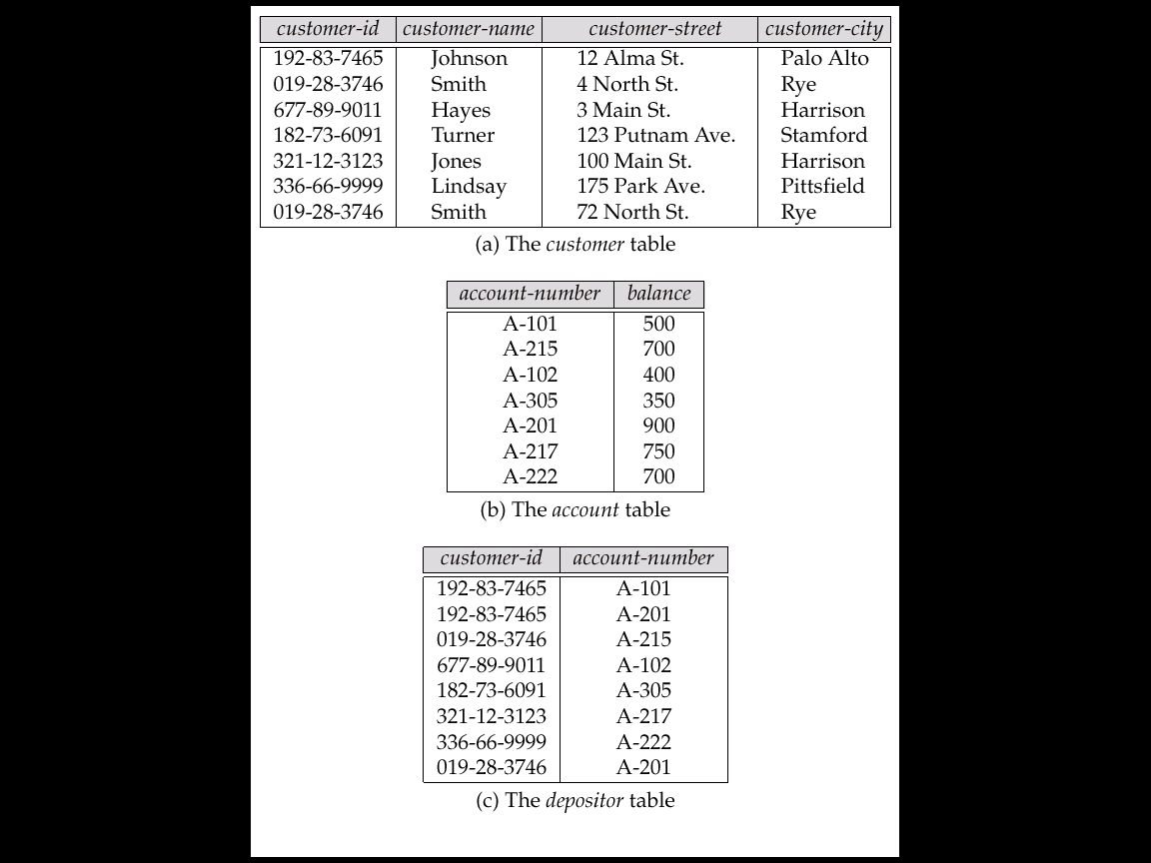
A Sample Relational Database

Slide 21
E.R Model
Construct an E.R diagram for a “Car–insurance” company whose Customers own one or more cars each.Each car has associated number of accidents with it, ranging from zero to any number of recorded accidents.
List of Entities in this scenario:
Person
Car
and ……..?
Accident

Slide 22
E.R.Model for car Insurance company
address
license
model
year
Driver-id
name
Driver-id
owns
car
car
person
location
Report-no
date
driver
participated
accident
Damage-amount

Slide 23
Relational table of car insurance co.
CAR
PERSON
DRIVER- ID | Address | Name
101 | ravi | Civil lines
102 | rajesh | M.G Road
150 | Nitin | Civil lines
license | model | year
de-240811 | Maruti-zen | 1998
Bb-39101 | Maruti alto | 2004
Gg-45001 | Tata sumo | 2003
ACCIDENT
Report- no. | location | date
02- 203 | Vivekanand nager | 02-01-04
05-503 | Civil lines | 29-03-04
06-405 | Ashram road | 15-04-04

Slide 24
Specialization
An entity set may include subgroupings of entities that are
distinct in some way from other entities in the set.
For e.g A subset of entities within an entity set may have
attributes that are not shared by all entites in the entity set.
It is represented by
IS A

Slide 25
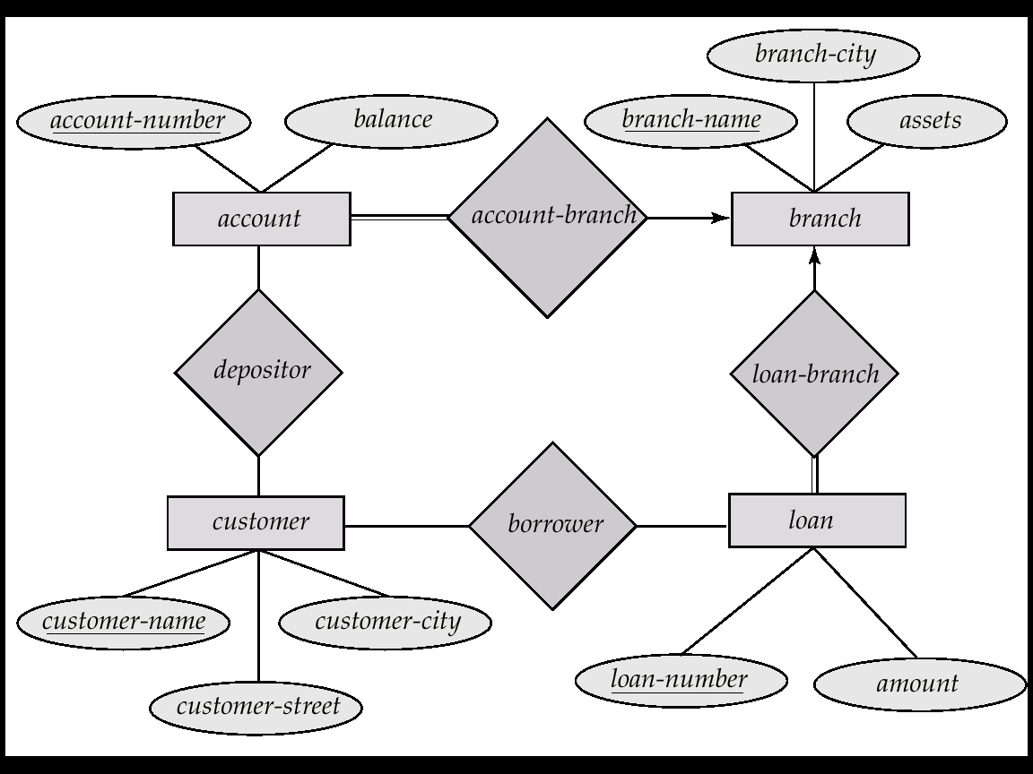
E-R Diagram for the Banking Enterprise

