Slide 1
If....else statements in c lang.
Dr. Vibha Dubey
Assistant Professor(H.O.D)
Dept. Of Computer
Durga College(Raipur C.G.)

Slide 2
Introduction
Generally C program statement is executed in a order in which they appear in the program. But sometimes we use decision making condition for execution only a part of program, that is called control statement. Control statement defined how the control is transferred from one part to the other part of the program. There are several control statement like if...else, switch, while, do....while, for loop, break, continue, goto etc.

Slide 3
if statement
Statement execute set of command like when condition is true and its syntax is
If (condition)
Statement;
The statement is executed only when condition is true. If the if statement body is consists of several statement then better to use pair of curly braces. Here in case condition is false then compiler skip the line within the if block.

Slide 4
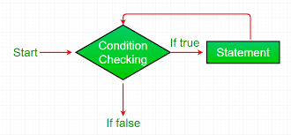
Flow Chart Diagram of If Statement

Slide 5
Example:-
void main() {
int n;
printf (“ enter a number:”);
scanf(“%d”,&n);
If (n>10)
Printf(“ number is grater”);
}
Output:
Enter a number:12
Number is greater

Slide 6
if…..else ... Statement
it is bidirectional conditional control statement that contains one condition & two possible action. Condition may be true or false, where non-zero value regarded as true & zero value regarded as false. If condition are satisfy true, then a single or block of statement executed otherwise another single or block of statement is executed

Slide 7
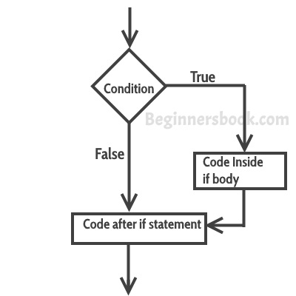
Flow Chart Diagram of If else Statement

Slide 8
Its syntax is:-
if (condition)
{
Statement1;
Statement2;
}
else
{
Statement1;
Statement2;
}

Slide 9
Else statement cannot be used without if or no multiple else statement are allowed within one if statement. It means there must be a if statement with in an else statement.

Slide 10
Example:-
void main()
{
int n;
printf (“enter a number:”);
sacnf (“%d”, &n);
If (n%2==0)
printf (“even number”);
else
printf(“odd number”);
}
Output: enter a number:121
odd number

Slide 11
Nesting of if …else
Nesting of if …else When there are another if else statement in if-block or else-block, then it is called nesting of if-else statement.

Slide 12
Syntax is :-
if (condition)
{
If (condition)
Statement1;
else
statement2;
}
Statement3;
else
statement4;

Slide 13
If….else LADDER
If….else LADDER In this type of nesting there is an if else statement in every else part except the last part. If condition is false control pass to block where condition is again checked with its if statement.

Slide 14
Syntax is :-
if (condition)
Statement1;
else if (condition)
statement2;
else if (condition) statement3;
else
statement4;

Slide 15
THANK YOU

