Slide 1
Java Database Connectivity
Enterprise Application Development
Presented By
Dr. Monika Patel
Asst. Professor Computer Dept Durga College Raipur(CG)

Slide 2
Topics
  JDBC
  API
  Architecture
  Types of Drivers
  Conceptual Components
  ODBC
  JDBC Data Types
Notes:
Prevention: locks at doors, window bars, walls round the property
Detection: stolen items are missing, burglar alarms, closed circuit TV
Reaction: call the police, replace stolen items, make an insurance claim …
Prevention: encrypt your orders, rely on the merchant to perform checks on the caller, don’t use the Internet (?) …
Detection: an unauthorized transaction appears on your credit card statement
Reaction: complain, ask for a new card number, etc.

Slide 3
JDBC
Definition
JDBC: Java Database Connectivity
  It provides a standard library for Java programs to connect to a database and send it commands using SQL
  It generalizes common database access functions into a set of common classes and methods
  Abstracts vendor specific details into a code library making the connectivity to multiple databases transparent to user
JDBC API Standardizes:
  Way to establish connection to database
  Approach to initiating queries
  Method to create stored procedures
  Data structure of the query result

Slide 4
JDBC
API
Two main packages java.sql and javax.sql
  Java.sql contains all core classes required for accessing database
  (Part of Java 2 SDK, Standard Edition)
  Javax.sql contains optional features in the JDBC 2.0 API
  (part of Java 2 SDK, Enterprise Edition)
Javax.sql adds functionality for enterprise applications
  DataSources
  JNDI
  Connection Pooling
  Rowsets
  Distributed Transactions

Slide 5
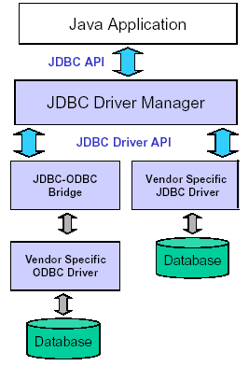
JDBC
Architecture
JDBC Consists of two parts:
  JDBC API, a purely Java-based API
  JDBC Driver Manager, which communicates with vendor-specific drivers that perform the real communication with the database
Translation to the vendor format occurs on the client
  No changes needed to the server
  Driver (translator) needed on client

Slide 6
JDBC
Drivers
JDBC uses drivers to translate generalized JDBC calls into vendor-specific database calls
  Drivers exist for most popular databases
  Four Classes of JDBC drivers exist
  Type I
  Type II
  Type III
  Type IV

Slide 7
JDBC
Drivers (Type I)
Type I driver provides mapping between JDBC and access API of a database
  The access API calls the native API of the database to establish communication
A common Type I driver defines a JDBC to ODBC bridge
  ODBC is the database connectivity for databases
  JDBC driver translates JDBC calls to corresponding ODBC calls
  Thus if ODBC driver exists for a database this bridge can be used to communicate with the database from a Java application
Inefficient and narrow solution
  Inefficient, because it goes through multiple layers
  Narrow, since functionality of JDBC code limited to whatever ODBC supports
Client
Application
Driver (Type I)
ODBC API
Native API
Database
API Protocol
Database Specific Protocol

Slide 8
JDBC
Drivers (Type II)
Type II driver communicates directly with native API
  Type II makes calls directly to the native API calls
  More efficient since there is one less layer to contend with (i.e. no ODBC)
  It is dependent on the existence of a native API for a database
Client
Application
Driver (Type II)
Native API
Database
API Protocol
Database Specific Protocol

Slide 9
JDBC
Drivers (Type III)
Type III driver make calls to a middleware component running on another server
  This communication uses a database independent net protocol
  Middleware server then makes calls to the database using database-specific protocol
  The program sends JDBC call through the JDBC driver to the middle tier
  Middle-tier may use Type I or II JDBC driver to communicate with the database.
Client
Application
Driver (Type III)
Middleware Server
Database
Net Protocol
Database Specific Protocol

Slide 10
JDBC
Drivers (Type IV)
Type IV driver is an all-Java driver that is also called a thin driver
  It issues requests directly to the database using its native protocol
  It can be used directly on platform with a JVM
  Most efficient since requests only go through one layer
  Simplest to deploy since no additional libraries or middle-ware
Client
Application
Driver (Type IV)
Database Specific Protocol
Database

Slide 11
JDBC
Conceptual Components
Driver Manager: Loads database drivers and manages connections between the application and the driver
Driver: Translates API calls into operations for specific database
Connection: Session between application and data source
Statement: SQL statement to perform query or update
Metadata: Information about returned data, database, & driver
Result Set: Logical set of columns and rows of data returned by executing a statement
DriverManager
Creates
Connection
Creates
Statement
Creates
Result Set
Driver
Established
Link to DB
Database

Slide 12
JDBC
Open Database Connectivity (ODBC)
A standard database access method developed by the SQL Access group in 1992.
  The goal of ODBC is to make it possible to access any data from any application, regardless of which database management system (DBMS) is handling the data.
  ODBC manages this by inserting a middle layer, called a database driver , between an application and the DBMS.
  The purpose of this layer is to translate the application's data queries into commands that the DBMS understands.
  For this to work, both the application and the DBMS must be ODBC-compliant, that is, the application must be capable of issuing ODBC commands and the DBMS must be capable of responding to them.
ODBC Interface

Slide 13
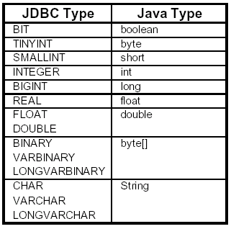
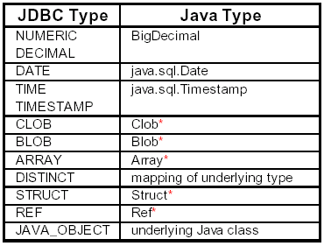
JDBC – Data Types

