Slide 1
Medium of Communication
Pratibha Khandelwal
Assistant Professor
Education Department
Durga Mahavidyalaya

Slide 2
Medium of Communication
Communication is possible through vast variety of media. The communicator has to be very careful and judicious in the choice of the medium, which depends upon
Intellectual levels of the receivers
Urgency and confidentiality
Expenditure involved
Nature of information (lengthy, complexity)
Need for record, direction of flow

Slide 3
Media of Communication
Media of communication
verbal
Oral
Written
Non -verbal
Sign language
Body language
Audio
Visual
para language
Space language
Time language
Silence
Artifactual

Slide 4
Verbal Communication
The form of communication in which words are involved either spoken or written.
Oral Communication | Written Communication
Saves Time and money More forceful Conveys shades of meanings Immediate feedback Immediate clarification More effective Can be informal Good for interpersonal relation | Accurate Precise Permanent record Legal document Formal and authoritative Suitable for complex data Suitable of statistical data Can reach large audience

Slide 5

Non-verbal Communication
When the communication is transmitted without the use of words it is called non-verbal communication
It is spontaneous
It carries cultural bias
It co-exists with verbal communication
It is more reliable than verbal
It needs to be interpreted in context
It is not suitable for complex messages

Slide 6



Sign Language
Visual Signs
Audio Signs – Hooters, Alarms, Sirens….

Slide 7
Body Language(Kinesics)
Body language includes
Facial expression
Gestures
Body movements
Posture
Eye contact
Touch

Slide 8
Paralanguage
It suggests not what is said but how it is said. It refers to vocal characteristics like
Tone (gentle, sarcastic, angry…)
Pitch (if constant, produces monotony)
Pauses (at right places is important)
Stress (important words should be stressed)
Speed of delivery (fluency is not speaking fast)
Speech breakers (oh, er, uh…..)
I have never seen you dressed so smartly before.
Mary is very punctual, in coming late.

Slide 9
Space Language(Proxemics)
The space between two interacting person defines the level of intimacy between them. It is of four types
Intimate Zone ( 0 to 18 inches)
Friendly Zone (18” to 4 feet)
Social Zone (4 to 10 feet)
Public Zone (over 10 feet)

Slide 10
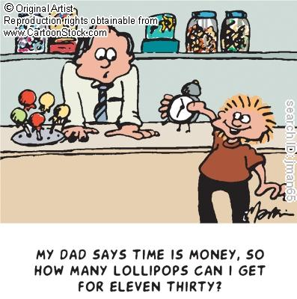
Time Language(Chronomics)
Time influences the communication process in the subtle manner. How people handle time reflects on their personalities.

Slide 11
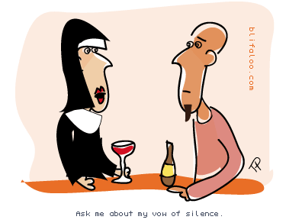
Silence
Silence is more eloquent than words. What it means depends upon the context. It is most suitable for responses like fear, respect….

Slide 12

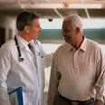
Haptics
This is one of the earliest methods among human beings.
A gentle pat on the back, a warm hand-shake or simply holding hands can express more than lengthy speech.
Mothers, lovers and teachers use touch effectively

Slide 13
Artifactual Communication
It includes
Physical setting of the room/office
Dress and accessories
Choice of colors
            Red: passion, love
            Blue:: calmness
            Green: coolness
            Black: sadness
            Orange: sacrifice
            White: purity

Slide 14

Thank you

