Slide 1
OS Memory Management
Presented By
Ravindra Singh Rajput
Asst. Professor Computer Dept Durga Mahavidyalaya Raipur(CG)

Slide 2


OS - Memory Storage and Management
1. Each process must have enough memory in which to execute, and
It can neither run into the memory space of another process,
Nor be run into by another process.

Slide 3
OS - Memory Storage and Management
1. The different types of memory in the system must be used properly so that each process can run most effectively.

Slide 4


Cache Memory
Cache - A section of a computer's memory which temporarily retains recently accessed data in order to speed up repeated access to the same data.
It provides rapid access without having to wait for systems to load.

Slide 5
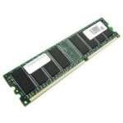
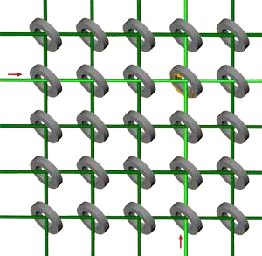
RAM Memory
Random access memory (RAM) is the best known form of computer memory.
  RAM is considered "random access" because you can access any memory cell directly if you know the row and column that intersect at that cell.

Slide 6
RAM Memory
The more RAM your computer has, the faster programs can function. The two main types are called DRAM and SRAM. SRAM is faster than DRAM, but, more expensive.
Remember, that if the power is turned off, then all data left in RAM, that has not been saved to the hard drive, is lost.

Slide 7
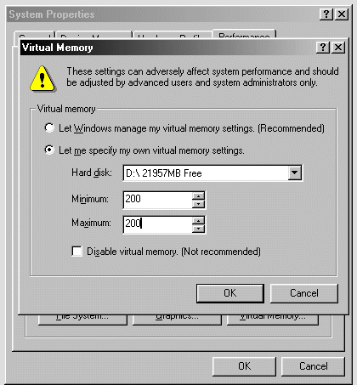
Virtual Memory
Virtual Memory – a method of using hard disk space to provide extra memory. It simulates additional RAM.
  In Windows, the amount of virtual memory available, equals the amount of free RAM plus the amount of disk space allocated to the swap file.

Slide 8
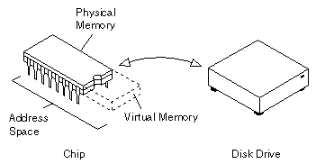
Virtual Memory – Swap File
A swap file is an area of your hard disk that is set aside for virtual memory. Swap files can be either temporary or permanent.

Slide 9

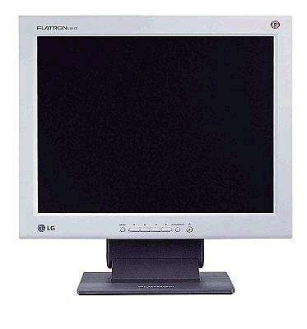

Okay – So Now What?

Slide 10



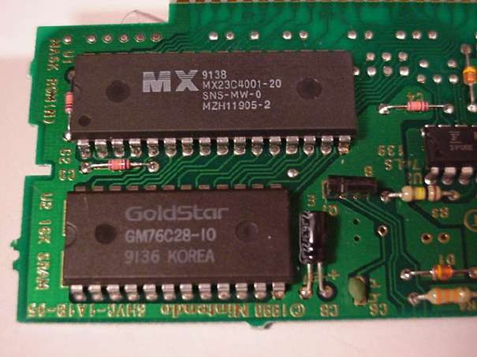
OS - Wake up call
When you turn on the power to a PC, the first program that runs is a set of instructions kept in the computer's read-only memory (ROM).

Slide 11

OS - Wake up Call
It checks to make sure everything is functioning properly.
It checks the CPU, memory, and basic input-output systems (BIOS) for errors.

Slide 12

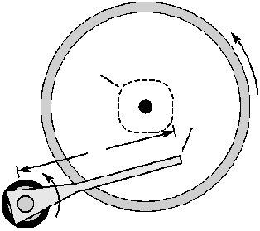

OS – Wake up Call
Once successful, the software will begin to activate the computer's disk drives.
It then finds the first piece of the operating system: the bootstrap loader.

Slide 13
OS - Booting the PC
The bootstrap loader is a small program that has a single function: It loads the operating system into memory and allows it to begin operation.

Slide 14

OS - Booting the PC
The bootstrap loader sets up the small driver programs that interface with and control the various hardware.
It sets up the divisions of
  memory
  user information, and
  applications.

Slide 15
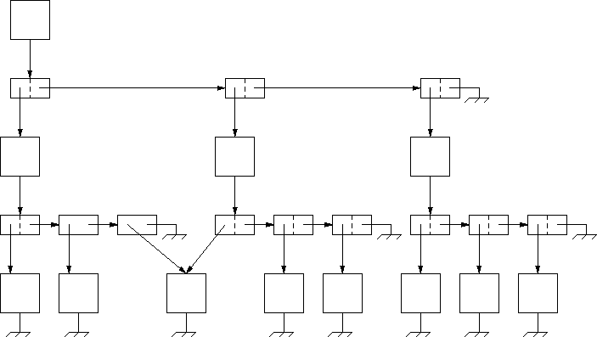

OS - Booting the PC
It establishes the data structures needed to communicate within and between the subsystems and applications of the computer.
Then it turns control of the computer over to the operating system.

Slide 16
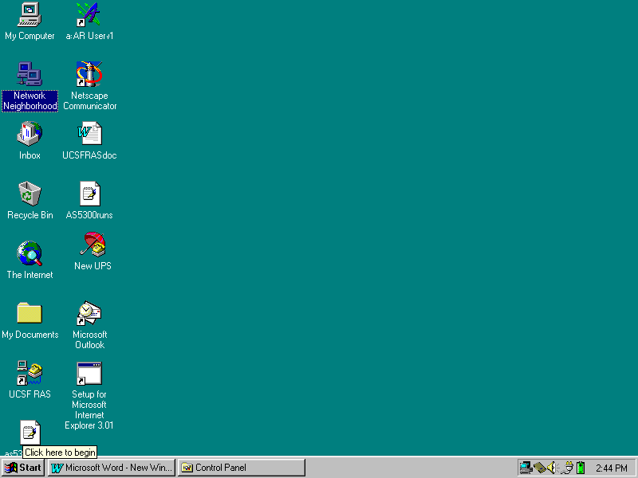
Windows Desktop
Your Desktop may look like this…

Slide 17
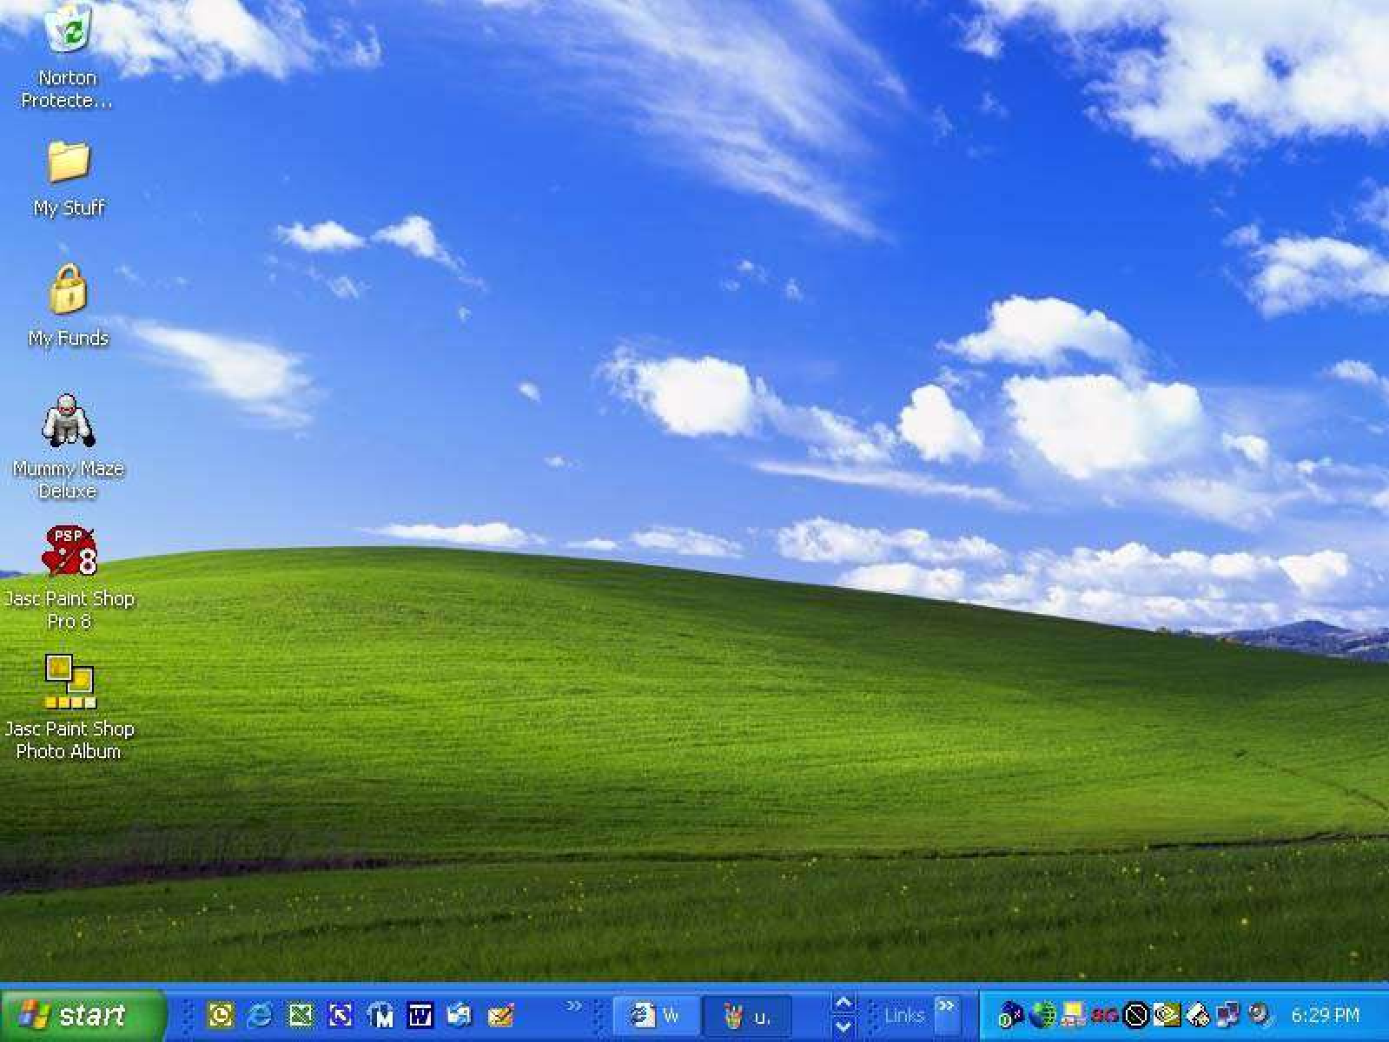
Windows Desktop
…Or like this.

Slide 18

How Do I Tell The OS What I Want To Do?
You must continue to give the operating system commands that are accepted and executed.
  The first command was pushing the “ON” button which started the “boot” process.

Slide 19
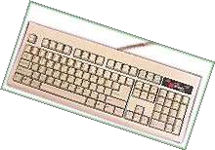


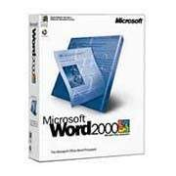
Enter Commands
Commands can be entered several ways:
  Through a keyboard.
  Pointing or clicking on an object with a mouse.
(Graphical User Interface or GUI)
  Sending a command from another program.

