Slide 1
Operating Systems
Presented By
Ravindra Singh Rajput
Asst. Professor Computer Dept Durga Mahavidyalaya Raipur(CG)

Slide 2

Operating Systems

Slide 3
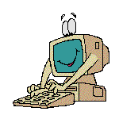
What is an Operating System?
The most important program that runs on your computer. It manages all other programs on the machine.
Every PC has to have one to run other applications or programs. It’s the first thing “loaded”.

Slide 4
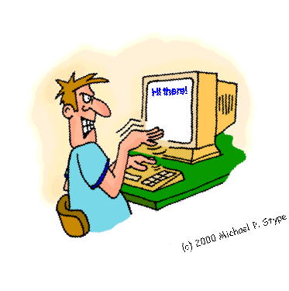
Operating System
It performs basic tasks, such as:
  Recognizing input from the keyboard or mouse,
  Sending output to the monitor,

Slide 5

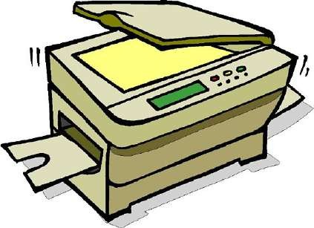
Operating System
Keeping track of files and directories on the disk, and
Controlling peripheral devices such as disk drives and printers.

Slide 6
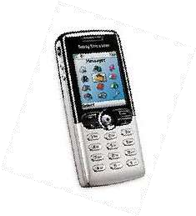
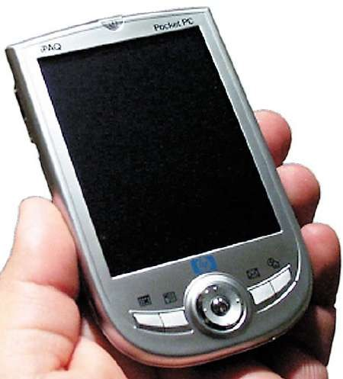
Is There More Than One Type of OS?
Generally, there are four types, based on the type of computer they control and the sort of applications they support.
  Single-user, single task
This type manages the computer so that one user can effectively do one thing at a time.

Slide 7











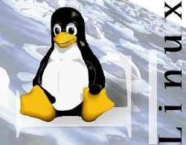
Types of Operating Systems
2. Multi-user, multi-task
Allows two or more users to run programs at the same time. Some operating systems permit hundreds or even thousands of concurrent users.

Slide 8
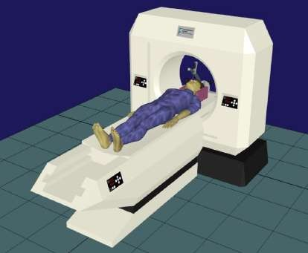

Types of Operating Systems
3. Real Time Operating Systems
RTOS are used to control machinery, scientific instruments, and industrial systems.
There is typically very little user- interface capability.
Resources are managed so that a particular operation executes precisely the same every time.

Slide 9
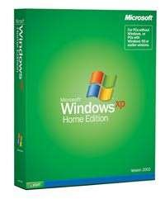
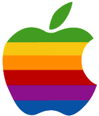
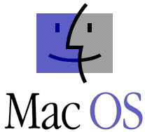
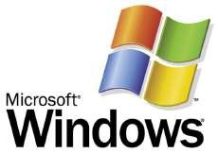
Types of Operating Systems
4. Single-user, Multi-tasking
This is the type of operating system most desktops and laptops use today.
Microsoft’s Windows and Apple’s MacOS are both examples of operating systems that will let a single user have several programs in operation at the same time.

Slide 10

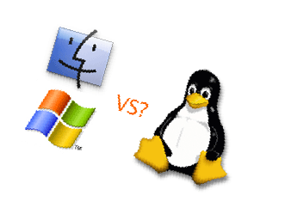
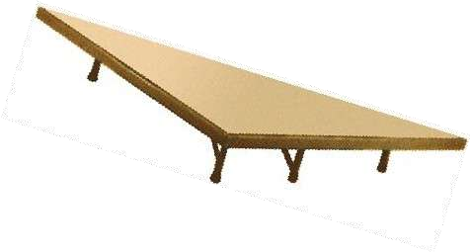
OS’s Manage Applications
Operating systems provide a software platform on top of which other “application” programs can run.
  The application programs must be written to run on a particular operating system.
  So, your choice of operating system determines what application software you can run.

Slide 11
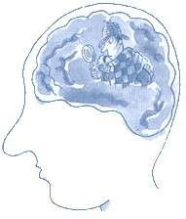
Operating System Functions
Besides managing hardware and software resources on the system, the OS must manage resources and memory.
  There are two broad tasks to be accomplished.

