Slide 1
Dr. Protibha Mukherjee Sahukar
Assistant Professor and Principal
Department of English
Durga Mahavidyalaya, Raipur (C.G.)
Semester I
William Shakespeare’s The Tempest
14/08/23

Slide 2
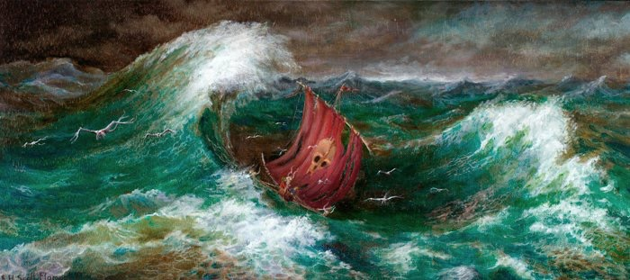
William Shakespeare’s
The Tempest

Slide 3
Remember:
“Shakespeare gives you a passport through life-a 360 degree view of what it is to be human”

Slide 4

SOURCES
The truly original work by Shakespeare.
Inspired by Italian Commedia Dell’Arte stories of shipwrecked sailors.
Recounts 1609 shipwreck in Bermuda of Virginia-bound colonists.Written late 1610 or 1611.
First published in the First Folio, 1623.

Slide 5
SETTING
The Enchanted Island: Before the Cell of Prospero (1797)
The actual location of the island is not known

Slide 6
The Character Pyramid
Prospero
absent Sycorax
Miranda
Ferdinand
Caliban
Ariel
Antonio
Sebastian
Alonso
Gonzalo
Stephano
Trinculo
Spirits
Boatswain

Slide 7
Introduction
The Tempest is thought to be the last play.
There are two prequels and three plots in the story

Slide 8
Prequel: 1
Sycorax, Caliban and Ariel lived on the island.
Sycorax commanded Ariel to use it’s magic for bad and Ariel refused.
Sycorax casts a spell that trapped Ariel within a tree.
When Sycorax died, Ariel stayed trapped in the tree until 12 years later when Prospero released it.

Slide 9
Prequel:2
Twelve years ago, Prospero was the Duke of Milan.
His brother (Antonio) was jealous and plotted against Prospero with the King of Naples (Alonso).
One night, Prospero and his young daughter Miranda were seized, thrown into a small boat and pushed into the ocean.
Luckily, Prospero’s old friend, Gonzalo, had crept to the boat earlier and hidden food, water and Prospero’s books to help his friend survive.
Prospero and Miranda came ashore at an island where they found the monster Caliban and Prospero released Ariel from the tree.

Slide 10
The play contains music and songs that evoke the spirit of enchantment on the island.
It explores many themes including magic, betrayal, revenge, and family.

Slide 11

The Themes
Forgiveness: all ends in reconciliation and peace, with music intensifying the enchantment.
the relationship between natives and invaders, the problem of forced labour.
the ‘element of magic’ and its representation as ‘theatrical illusion’.
Two types of magic
Maleficent(causing harm esp supernatural)- Sycorax works evil
Beneficent- Prospero derives from study; used for good purposes

Slide 12
The play is about establishing and maintaining Renaissance ideas of power.
The play must be read in a colonial and political context.

Slide 13
The Eurocentric View
The play is a comment on the idea of the Great Chain of Being, which held that the world’s creatures existed in a divinely ordered hierarchy where God is Supreme, Man being the cherished creation, followed by other organisms-namely animals, plants and so on.
Accordingly Prospero’s domination of Caliban is right and proper as Caliban is on a lower rung than Prospero.

Slide 14
The Other Side
There is no doubt that Shakespeare was challenged by the events unfolding in the new world.
The play is about the conflict between the prince and the savage.
The savage, Caliban, challenges the princes right to sovereignty. The island is his birthright and was unjustly taken from him.

Slide 15
The Second Side
The Tripartite (involving 3 parts) Soul
One of the major themes OF this play is the belief the "tripartite of the soul,” (a very commonly held belief in the Renaissance).
The idea is that Prospero, Caliban, and Ariel are all a part of one person (Prospero).
The three factions of the soul were vegetative (Caliban), sensitive (Ariel), and rational (Ariel and Prospero).
Sigmund Freud later adopted this concept into his id, ego, and superego theory.
By this theory, Caliban represents the "id" (the child), Prospero the ego (the adult), and Ariel the superego (the parent).

Slide 16
THE TEMPEST—LAST PLAY
Prospero’s farewell———————Shakespeare’s farewell
Leaves the isolated islan————Leaves the isolated world
Shakespeare and Prosper———————same use of art

Slide 17
Struggles of Rival Interests Are virtually everywhere in the play:
  Prospero and Antonio
  Opening scene between aristocrats and sailors
  Prospero and Ariel
  Caliban and Prospero
  Antonio and Sebastian and Alonso and Gonzalo
  Trinculo and Stephano working with Caliban to overthrow Prospero
  This is concerned with the questions of power and legitimate rule that are key to depictions of colonialism.

Slide 18
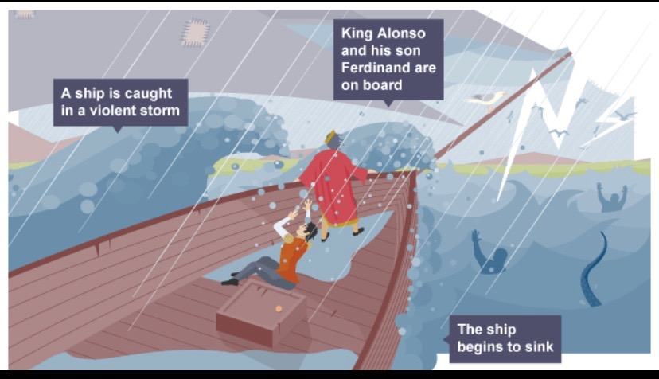
The play opens with a huge storm (a tempest).

Slide 19
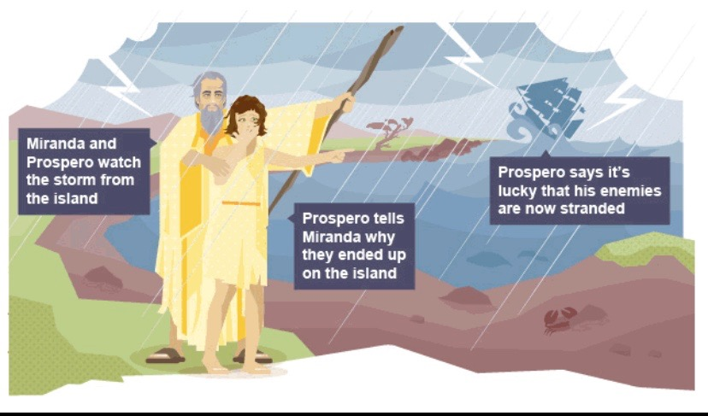
Prospero tells Miranda that he caused the storm.

Slide 20
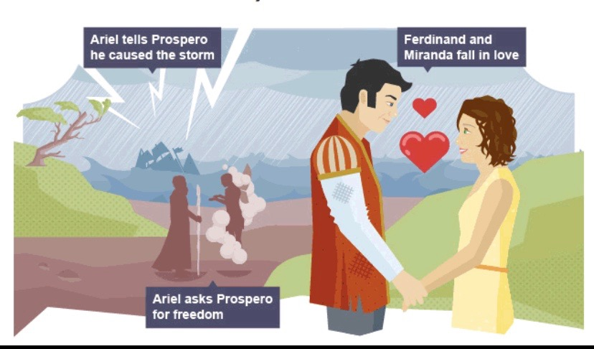
Ariel fetches Ferdinand, who falls in love with Miranda.

Slide 21
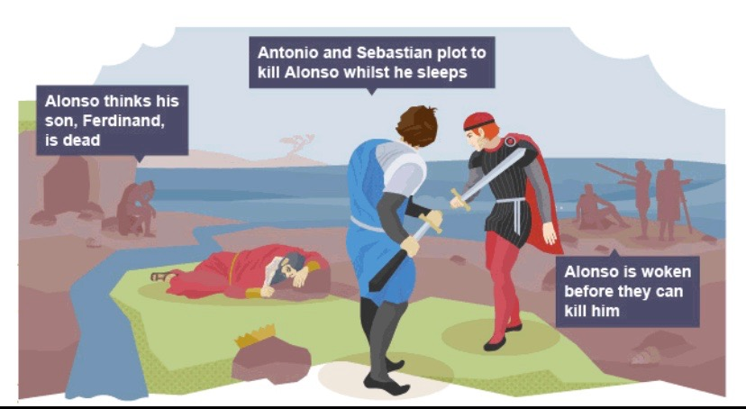
Antonio and Sebastian plot to kill Alonso, the King of Naples.

Slide 22
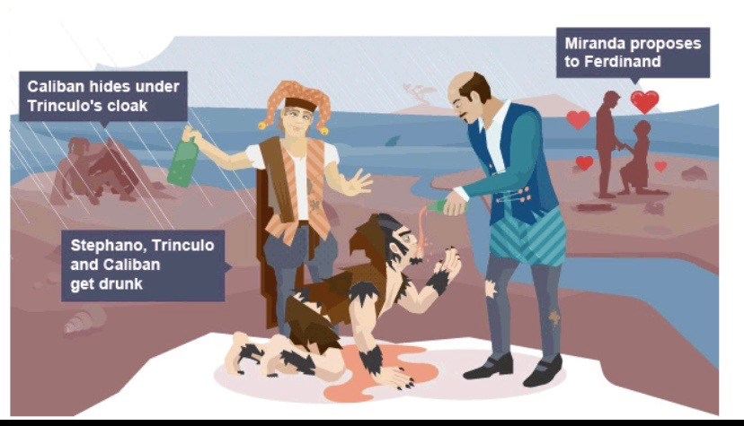
The ship’s jester and butler meet Caliban and feed him alcohol.

Slide 23
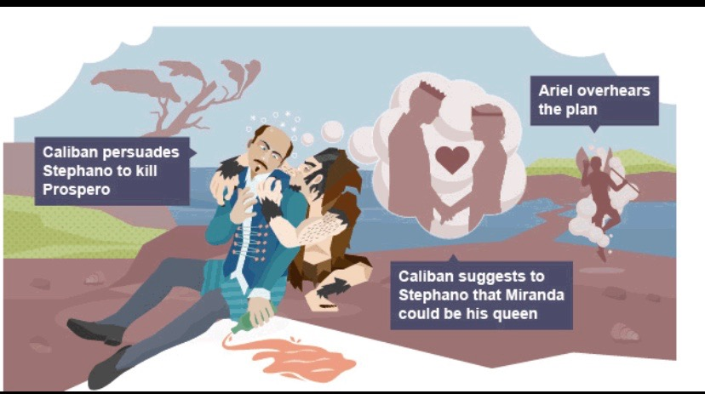
Caliban suggests that they should kill Prospero, and Ariel overhears.

Slide 24
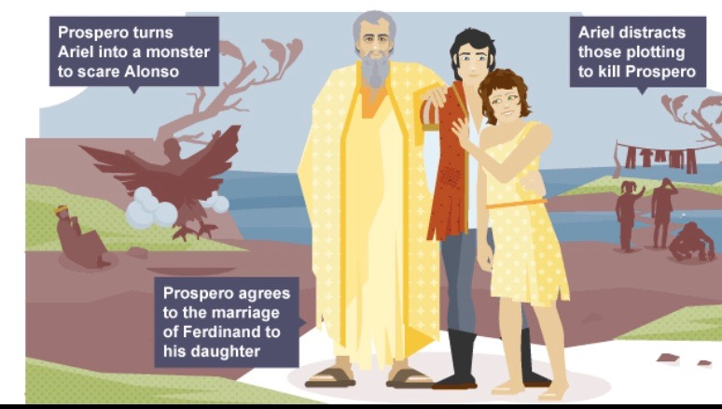
Prospero uses magic to scare Alonso and spoil Caliban’s plot.

Slide 25
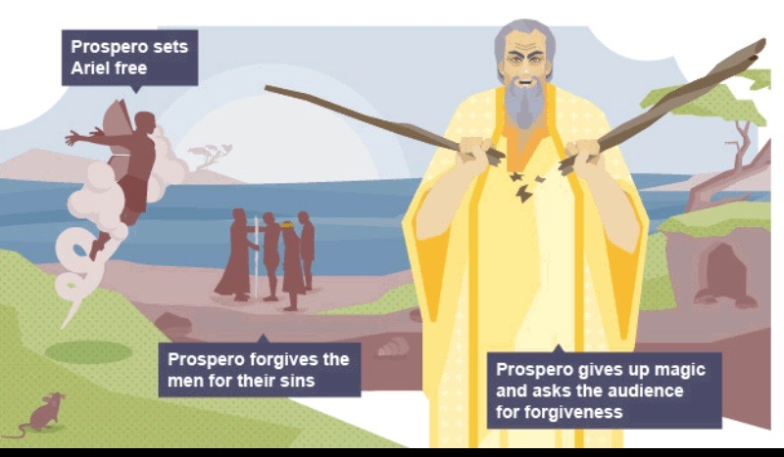
Prospero forgives everyone for their former betrayals.

Slide 26
