Slide 1
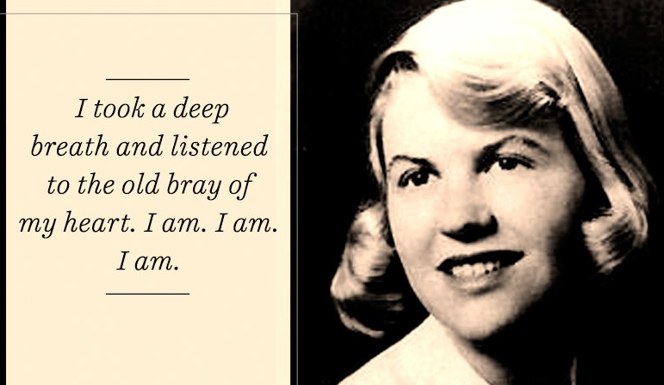
SYLVIA PLATH
Pseudonym is Victoria luces
DR. MADHU KAMRA
HOD,ASSISTANT PROFESSOR
DEPARTMENT OF ENGLISH
DURGA MAHAVIDYALAYA
madhukamra09@gmail.com

Slide 2
1.ABOUT THE POET
- well known American poet
- Best known for her novel The Bell Jar
- Poetry collections are the colossus and Ariel
- Married to Ted Hughes and mother of two-Freida and Nicholas

Slide 3
2.FEATURES OF PLATH’S POETRY
In Plath’s poetry
1. everything is a symptom of the same Holocaust death is everywhere and the possibilities of dying making it into a perfected art work endless infinite
2. Plaths “speaking voices” always remains individual
3. Annete Levers writes The Art of Sylvia Plath : Her theme of vulnerability creates an impression of an “overall threat”
4. The mood in her poetry is always negative and ranges from mere foreboding to hopeless revolt and utter despair

Slide 4
3. Confessional poetry
a term covered by M.L Rosenthal in 1959
expressions of - self destruction- conflicted relations - unsettled minds - excessive sensitivity- lacreating sensitivity- psychological vulnerability
release of inner hostility and animosity

Slide 5
4. Lady Lazarus
written on 23 October, 1962
was recorded for BBC on Oct 30 ,1962
published in the magazine Encounter, Vol 21, No 4 in October 1963
a sister poem to “Ariel” and “Fever 103”
the title is Lazarus is taken from the parasle of John in the Bible

Slide 6
5.STRUCTURE
a bitter dramatic monologue
written in 28 stanzas - symbolising 28 days of the normal female menstrual cycle

Slide 7
6.TITLE OF THE POEM
underlines the two binary opposition life versus death
also forms a contrast between the biblical figure Jesus/ Lazarus and Plath herself

Slide 8
7. The poem singularly focuses on
1) her maimed self
2) here the self is described as—
What a trash
To annihilate each
What a million decade filament
3) battle with mental illness and psychiatric treatment
4) describes inner-life as a wasteland

Slide 9
8. Concept of death
a transformed identity
death embodies three- part structure of a myth-
a) entry into darkness
b) ritual death
c) resinth
a sort of personal catharsis

Slide 10
9. Summary of the Poem
The poem begins with an event of the past her suicide attempt
She calls herself a “walking miracle” with an admittance that her survival was an unbelievable happening. Her face is pale and her right foot is as heavy as a paper weight. Her palor is connected to lampshade the Nazi community made out of the skin of Jewish Holocaust deeds.
Her face looks like that of a mummy wrapped in Muslin cloth

Slide 11
10.Continuation of Summary
Her breath is badly smelly due to the stretch of decay. She reminds her readers of her age 30 and says that she has had nine lives like a cat. Numbering her life as a third she says that she attempts self destruction after a decades and this is third one
To the poetess dying is an art and it is easy enough to die in a cell like lunatic bin. She addresses her doctor as her enemy who succeeded twice in bringing her back to life. They behold her as their most prized possession.

Slide 12
11. Continuation of the Summary
Her body is like ‘a spectacle’ to ‘peanut crunching crowd’ denouncing the macavre interest of the people in others life. She therefore name her death and resurrection “theatrical” “The big strip tease” such a spectacle is created when she is forcibly resurrected which she names as “theatrical comeback”

Slide 13
THANK YOU

