Slide 1

SPEAKING SKILLS
Pratibha Khandelwal
Assistant Professor
Department of Education
Durga Mahavidyalaya

Slide 2
SPEAKING SKILLS
Achieving desired clarity and fluency; effective speaking; task-oriented, inter-personal, informal and semi-formal speaking.
Meetings, Seminar, Conferences, Interviews, Presentation, Audio-Visual Communication.

Slide 3
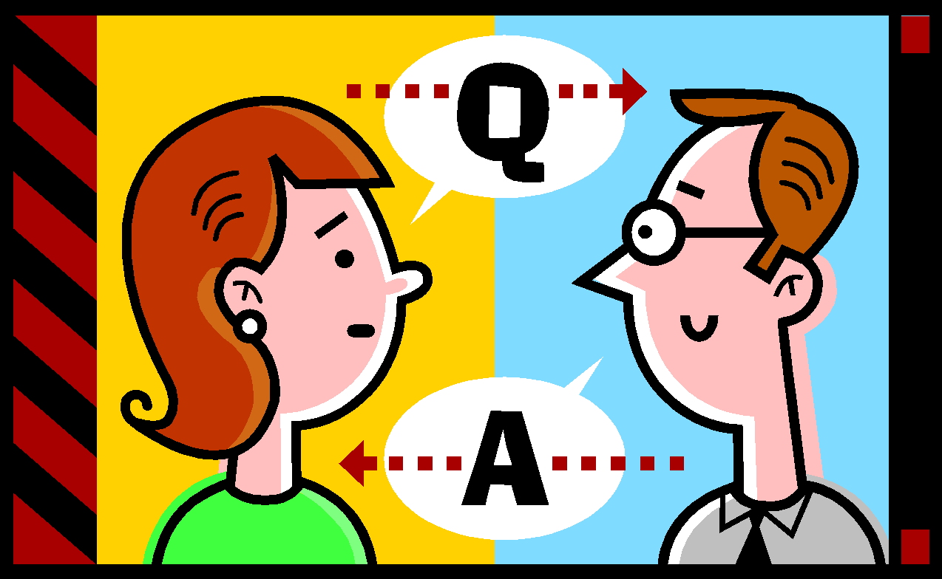
Meaning of Speaking
Communication among people take place in two forms : Verbal and Non-Verbal.
Speaking is a part of verbal communication. It is an oral expression of knowledge, view-points, emotions and feelings through words.
It is used to inform, instruct, praise, inquire, express, address, lecture, converse and criticize.

Slide 4

Speaking is not only a verbal activity, we speak equally with all our non-verbal means too. Research by Albert Mehrabian shows that our total message in speech is comprised as follows:
7% deals with words and expression.
38% deals with voice, tone and manner of speaking.
55% deals with facial expression, gestures and postures.

Slide 5
Types of Speaking
Depending upon the style, manner and tone of speaking, it is divided into following types:
Formal Speaking
Informal Speaking
Semi-formal Speaking
Task-oriented Speaking
Inter-personal Speaking

Slide 6

Formal speaking
This type of speaking is bound with formality, hierarchical order, strict discipline and a particular vocabulary.
This is associated with organizational communication.
This does not involve personal matters.
Example : lectures, presentations, speeches.

Slide 7

Informal speaking
This type of speaking is not bound with formality, hierarchical order, strict discipline or particular vocabulary.
One is free to talk on personal matters.
What to speak, how and when depends upon the persons interacting.
Example: speaking at home, among friends

Slide 8
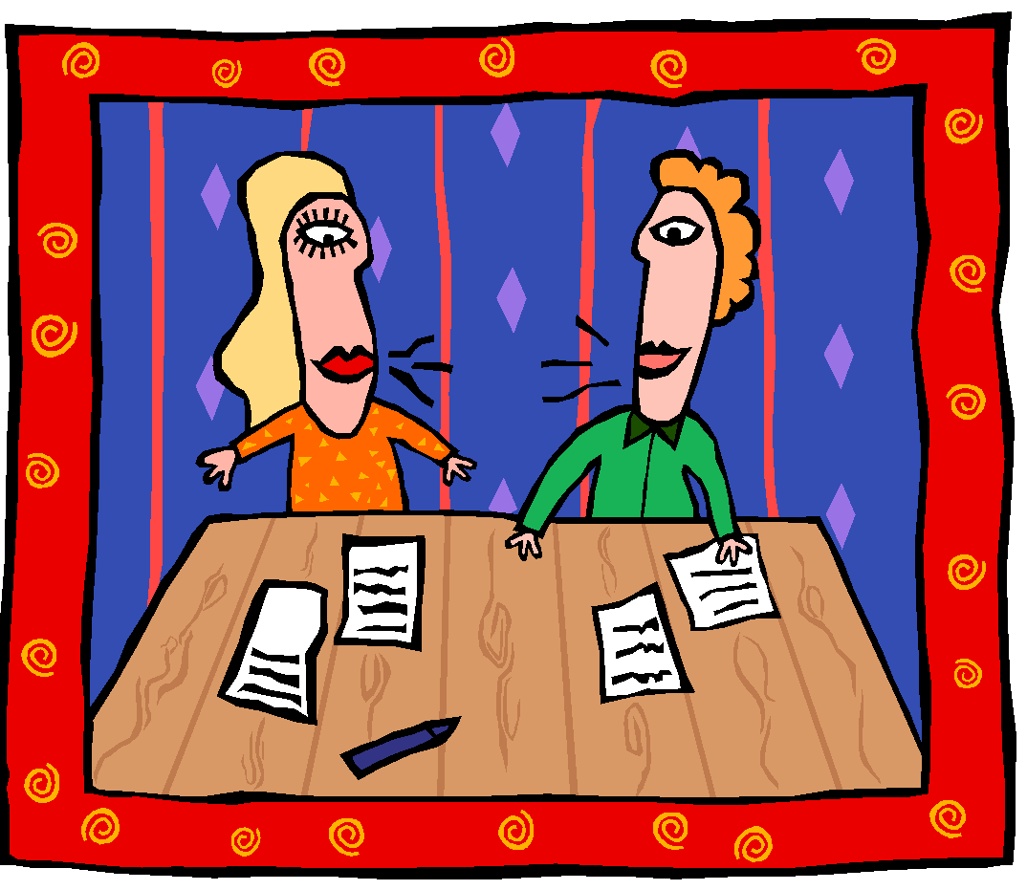
Semi-formal speaking
Semi formal speaking is concerned with conversation among colleagues, officers, employees related to the organizational issues, problems within an office or an organization.

Slide 9

Task-oriented speaking
This is similar to formal speaking.
This speaking is only for a particular task.
Listening to everyone’s opinion is must.
Example : managers and subordinates exchanging views regarding some particular problem (probable reasons for decline in demand of a product).

Slide 10

Inter-personal speaking
This is a communication which occurs between people who have known each other for some time. These people view each other as unique individuals and not just as people simply acting out in social situations. This is used for :
Gaining Information.
Building a context of understanding
To establish Identity
To fulfill our Interpersonal needs.

Slide 11


Social and Professional
Interpersonal Situations
Making Introductions
Making apologies
Making requests
Giving directions
Asking and answering questions
Speaking on the phone
Dealing with the differences
Offering and receiving criticism

Slide 12

Effective speaking
According to the social anthropologist, Edward T. Hall, in a normal conversation between two persons, less than 35% of the social meanings is actually transmitted by words and 65% of it is conveyed through the body (non-verbal channel). So for effective speaking two things are important
What you speak.
How you speak.

Slide 13

Essentials of effective speaking
As listeners can’t glance back or skip ahead, one needs to be exceptionally clear and repetitive. The elements essential for effective speaking are
Clear pronunciation and fluency
Effective style(pitch, speed and volume blend together)
Brevity and precision
Conviction and natural voice
Effective body language
Adaptation
Avoiding clicks and hackneyed phrases
An effective opening and preview
Stating the main points
Logical sequencing of content
Appropriate choice of word

Slide 14

Achieving desired clarity
Language learning depends upon practice.
Be an active listener.
Start with short, simple sentences.
Mirror face test.
Control non-word fillers.
Speak with clarity and pauses.
Take regular feedback.
Practice conversation (formal, informal, telephonic)
Once a learner starts speaking long sentences with clarity and pauses he should aim at fluency.

Slide 15

Achieving desired fluency
Fluency is a flow of words pronounced correctly with proper articulation, stress, intonation and spoken with moderate speed without the use of unnecessary pauses, non-word fillers and repetitions. Average speed of speaking fluent English is 150words/minute. Fluency can be developed by improving
Articulation(technique to modify voice, lips, tongue…)
Pronunciation(of 44 sounds in English)
Expression(adjusting tone and pitch)
Stress
Intonation

