Slide 1

Reassessing Children’s Literature
Dr. Madhu Kamra
Ph. D English; Ph. D Linguistics
Head, Dept. of English
Durga Mahavidyalaya, Raipur
Raipur, Chhattisgarh
Email ID: madhukamra09@gmail.com
Mobile No.: 7024101095

Slide 2
Why Children’s Literature
Extension of the warmth the comfort / the security they treasure.
Makes two world – concept clearer.
Construct the world beyond home, housed by other children, adults, Vegetative and Animal Kingdom.
Children are not born with ‘good taste’ by birth, books do the required pruning.

Slide 3
Why Neglect of Children’s Literature
The conceptual framework of society which unrecognised ‘Childhood’.
Childhood was fragile due to high morality rate and poor life span.
Parenting was not an organised enterprises.
A Child’s distinct needs ‘were not’ identified and recognised.
Society’s Vague conception about pedagogic vehicles
Children’s Literature for a writer was not prestigious.

Slide 4
Why Neglect of Children’s Literature
Children’s Literature first has its birth in oral fairy lates to serve the Salon Culture. In the slow travel of hundred years from 17th to 19th Century – The Perrault’s ‘Coddling’ attitude to Grimm’s ‘reasoning attitude’.

Slide 5
Physicality of Children’s Literature
Short Length for quick Reading
The structure for easy holding/ handling
Catchy Covers
Bold and Primary Colours
Bold letters
Interesting Motifs
Trendy Jackets
Sturdy Spine

Slide 6
Materiality and Texture
Adequate description
Concrete events
Emphatic action
Preponderance of Discourse
Limited Vocabulary
Narrow myths and mild pun

Slide 7
Materiality and Texture
7. Animals as supporters to the Protagonists
8. Avoidance of Excessive Emotion
9. Multifold and Manifold Horror
10. Affluence of Magic and Fantasy
11. A Rounded off story with end – on - feel of Justice to Prevail Optimism

Slide 8
What kind of stories?
Stories should tell a tale.
Concur with the age, the interest, the mood and the environment of the readers.
Stories with drama “makes things happens”.
Stories are relative to their way of feeling, thinking, reaction and a place of experiences.
Note – Demands little explicit attention of the critics.

Slide 9
Texture of Children’s Literature
Shorts Sentences
Simple dialogue
Limited lexicon/ Genuine Vocab
Child’s point of view
Minimal/ no embellishment to Circumstances.

Slide 10
Texture of Children’s Literature
6. According to Grimm in the later version – this new concept of childhood is explained in the following three aspects –
  The relations in the family Circle
  The innocence of the Child
  The need for instruction of the Child

Slide 11
Dormant state of Children’s Literature
1. Children’s literature analysis requires interdisciplinary approach and activity.
At the beginning the focus was primarily on plot character and settling and theme as stubbornly conservative approach.
Teaching of Children’s Literature is the University of Global stand is short in History of 35 Years.
In India, Children’s Literature is still waiting at the threshold academia to be awarded a specific academic unit.
Children’s Literature insisted on the usefulness of reading – to establish connection between pleasure and reflection.
Children are imaginative and creatives
Adults are rational creatures
Indicates a cross fertilized approach

Slide 12
Paradox of Children’s Literature
The voice and point of view of an adult author is inadequate.
Is the author sharing the experience of being a child.
Children’s literature is not owned by children.
Callousness to George Mac Donald’s cry – “do not write for Children, but for the childlike, Whether of five or fifty or Seventy - five. (A Dish of orts London: Sampson law, 1985)
Children’s literature is the only literature defined by its addresses.
Perry Nodelman raises a need for
“a space necessarily separate from the world of adults”.

Slide 13
How do Children respond?
The greater the involvement, the stronger is happiness binding due to gratification.
Benton and Fox elaborated how the reader creates a secondary world.
The reading experience is characterised in 2 ways-
a. A four phase process of feeling like:
                1. a. Reading
                b. Getting into story
                c. Being lost in the book
                d. An increasing sense of ending
2. On activity consisting of four elements:
a. Picturing
b. Anticipating and Restrospecting
c. Interacting
d. Evaluating

Slide 14
How Does Children’s Respond?
N. Tucker observed that children emphasizes on the “Quality of the writing” as opposed to the “Pace of the plot”.
During the primary phase ‘Acquiescent’ reading style is noticeable inclusive of (RAPS) responding – aloud protocols like-
  Paraphrasing
  Thematising
  Allegorising
  Problem Solving

Slide 15
Modes of Story Telling
Andrea Schwenke Wyile’s (1999- 2003) accounts of three types of narration Children’s Literature –
  Immediate
  Distant – Engaging
  Distancing Narration

Slide 16
What sells?
Best sellers are high or domestic fantasy.
Fantasy is unhindered vista by realistic constraints.
For adults, the secondary world of Fantasy provide the adult with a utopian unknown universe.
Commodification of the child’s innocence to a child reader. It encapsulates the essence of innocent – living, but for an adult, it is nostalgic and voyeuristic need.

Slide 17
New Steps
Peter Hunt pioneers “the childist criticism, which propounds that the child is not a mere paper being devoid of all power in the world of Children’s books.
Children’s literature is now considered a legitimate field of academic research.
Assertion of the concept that children’s literature is an important vehicle for achieving required aims of healthy education.
No longer occupies an inferior status within the literary polysystem.
Cultural institutions, Curriculum and National libraries as well as to Encyclopedia are now open to receive CL.

Slide 18
Purpose and Policy
Dormant sexuality in the west.
Assertion of Racism.
Projecting social misfits as real life people.
Nasty instances:
1. Lewis carroll known for inventing Alice’s Adventures in Wonderland whose criminal intent resulted in taking nude photographs of little girls.
2. William Mayne, popular British author of The Chair School Series (1955 – 1963) was put behind bass for assaulting several minor – girls of his fandom.
Ambiguous state between ‘Romantic’ or ‘Sentimental Portrayal’ of childhood.

Slide 19
Purpose and Policy
Attempts to extricate children’s Literature from the narrow boundaries to place it in the foreground of literary scholarship.
Attempts to check polarization.

Slide 20
What are Picture Books and Why
They are ‘Signs’ – Something [which] stands to somebody for something else in some respect or capacity (Umberto Eco).
As iconic signs they resemble what they depict – to see the actual in terms of fictional visualization of it.
They purport to “show” us what the words “tell”.
They are easy and smooth ways to integrate children into the ideology of our culture.
Trains young minds to mumble – “What do you mean?”

Slide 21
What are Picture Books and Why
7) Pictures need to have ideal optical for consistency.
8) Pictures capture Decisive moments which lessing calls as “Privileged moment” and picture has more of ‘Material limits’.
9) Locus of gaze is more defined and detailed.

Slide 22
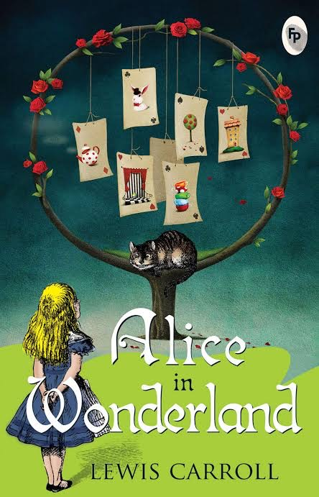
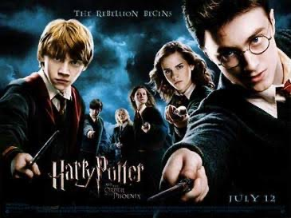
Cross – Over Literature

Slide 23
Popular Stories
Cinderella
Snow White
Rumpelstiltskin

Slide 24
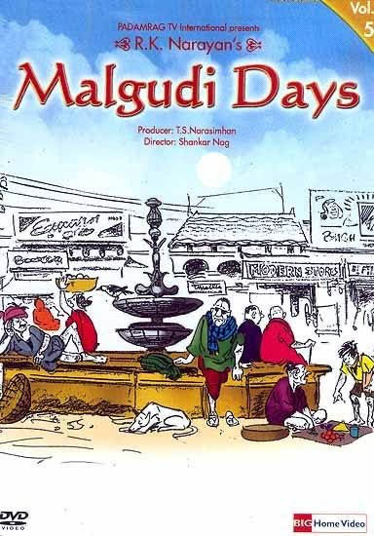
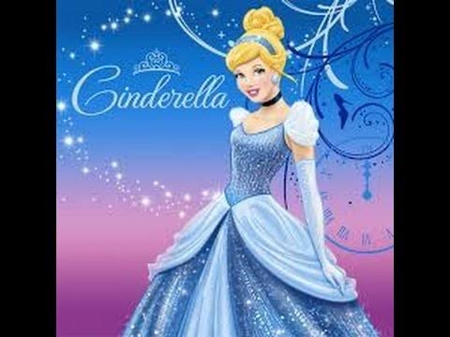
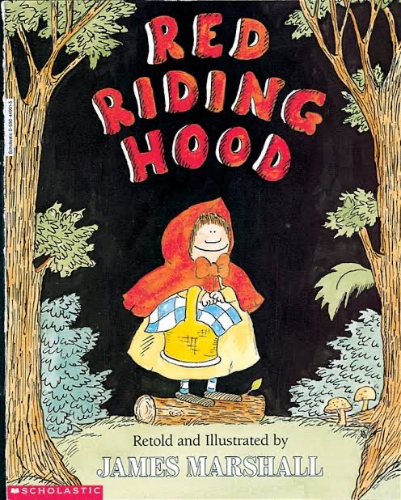
Children’s Literature Corpus

Slide 25
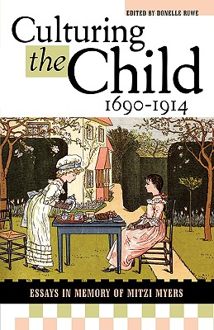
Theorist- Mitzi Myers
Mitzi Myers was a formative scholar who revived wee – wee stories and contributed richly to Encyclopaedia American and to the Cambridge companion. To her books were her biological children. Culturing The Child – 1690 – 1914 (2005) (Author: Danelle Ruwe) hints at agencies in children’s lives. Core themes are family, friends, neighbourhood, animal and vegetative kingdom along with airy World to contextualize agency in the cultures and voices of the future adults she had an extensive library for children’s book and was an extremely rigorous scholars. She worked with Zest and no sleep for “Kids turned into sophisticated consumers”.

Slide 26

Maria Nikolajeva
Aesthetic approaches to children’s Literature: An Introduction by Maria Niko LAJEVA .
As the title indicates, this is a marked approach to children’s Literature. The tool kit it suggests explores the aesthetics of content, Scene, Composition , Character, Narration and the like. A Professor of Comparative Literature at Stockholm University (Sweden), has authored books of immense analytical depth like: The Rhetoric of Children’s Literature, 2002 and From Myths to Linear Time in Children’s Literature 2000.

Slide 27
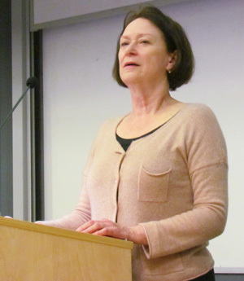
Carolyn Steedman
She says –
The interiorised self understand to be the product of a personal history was most clearly expressed in the idea of childhood; and the idea of ‘the child ’. The seem of technical knowledge about childhood increased dramatically in the middle years of the 19th century, and there was a Veritable explosion of information about the period of physiology and cognitive development in human being. A child is often reminded of its littleness – to the visceral sense of smallness of the self that lies inside then A child is associated with emotional tawdriness.
The develop of the self is not new but rather then “location of the self that is new”.

Slide 28
Cinderella: Projects “how collaborative efforts can heal a fractured society”
Mitzi Myers- Points out “Children’s literature suffer from ‘something like the critical equivalent of urban blight”(1986:31).
(Cinderella aided autonomy by the animal world devised)
Cinderella projects a ‘masculine's’ tradition of children’s literature Cinderella.
Children’s literature is the most conservative and conceptually orthodox as a genre in its approach and effect to mobilise young readers to assimilate the dominant literary codes of the culture.

Slide 29

Explore Zohar Shavit
Children’s Literature constitute one of Althusser’s Ideological State Apparatuses (see ideology). The literary polysystem contains as Shavit notes both canonical and non – canonical books. Children “read their Literature through books and films and shop windows and Magazines and Video games”. Here, culture and Market place are connected.

Slide 30
Reading ‘reading of Children’s Literature
Children’s literature is both ‘a wonder drug’ and ‘a making mould’.
Labelled as ‘Therapeutic’ by Butler (Cushla and her Books) who argues “picture books are instrumental in the rehabilitation of a multiple handicapped child”. In a broader sense children’s literature aid to ‘Bibliotherapy’.
A deep – impact story is mere of a “Intervention” programme.
Bibliotherapy helps child be a ludic reader (coinage by Victor Nell). So that he can construct his inner newsreel and be conscious of his inner responses.
Bibliotherapy helps children to regulate his inchoate.
Personally preferred Texts can regulate further reading.

Slide 31
Uses of Children’s Literature
Different opinion exist relating what is children’s literature for?
A Chambers in The Reading Environment: How Adult Help children Enjoy Books says – “Story telling is indispensable in enabling people to become literary readers”.
Jack Zipes a distinguished American Expert on children’s literature writes-
          If storytelling are to be effective on behalf of children in schools. It is important to try to instil a sense of community, self – reflecting and self – critical community in the children to demonstrate how the ordinary can become extraordinary. (1995: 6).

Slide 32
Uses of Children’s Literature
d. Children’s book are of world and one of the features of critical theory which has made it unattractive to many children’s book practitioners.
e. A storybook is required to condition the nature of understanding that the little reader has constructed through interaction and experience.
f. Children’s literature trains a growing mind in the complexities of meaning.

Slide 33
To Read More
Tucker N. Ed. Approaches to Research in Children’s Literature Southampton University 1980.
Stephens. J. Language and Ideology in Children’s Fiction. London: Longman, 1992.
Hunt, Peter. Ed. Understanding Children’s Literature. London: Routledge, 1999.
Wall, Barbara, The Narrator’s Voice: The Dilemma of Children’s Fiction Basing stoke, Macmillan, 1991.

Slide 34
Thanks for Being Along

