Slide 1
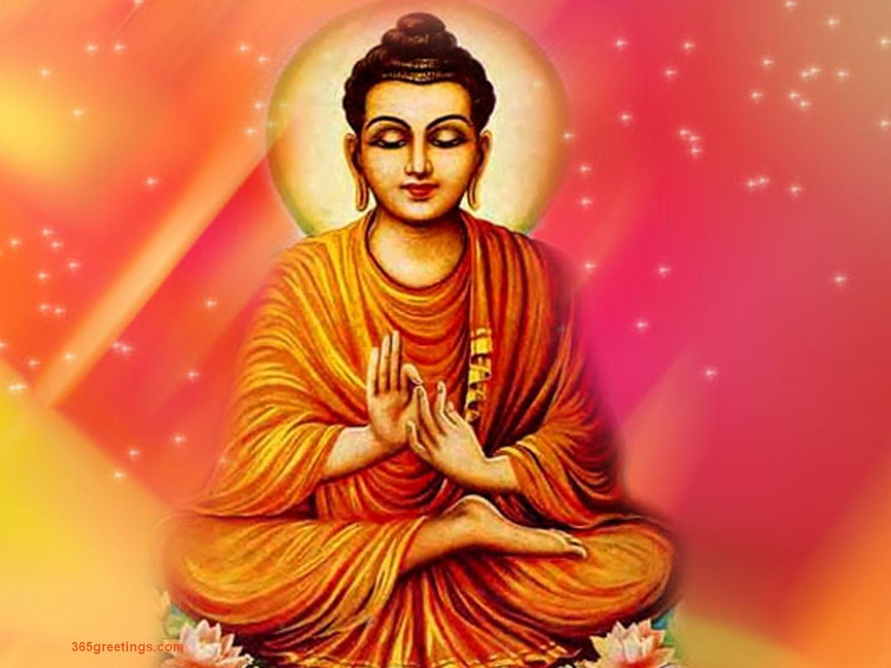
ASHTANGIK MARG of Gautam Buddha…
Presented by-
Dr. Ranjana Sharma
Dept. of Philosophy
Durga Mahavidyalaya
Raipur, C.G.

Slide 2
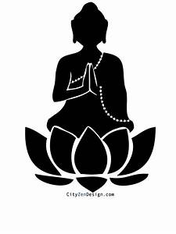
Historical Background…
Gautama Buddha was the founder of “Buddhism”.
He was born in Sixth century B.C. in a royal family.
His birth Place was Kapilavastu.
The place where he achieved Salvation/Nirvaan was Lumbini.
His father’s name was Shuddodhan and mother’s name was Maya.
He was married to Yashodhara and had a son named Rahul.
His childhood name was Siddharta.

Slide 3
Four Noble Truths…
There are Four Noble Truths.
The First Noble Truth is about “Suffering”.
The Second Noble Truth is about “Cause of Suffering”.
The Third Noble Truth is about the “Cessation of Suffering”.
The Fourth Noble Truth is about the “Path to liberation”. It comprises of 8 paths known as “Ashtaangik Marg”.

Slide 4
Ashtaangik Marg……
The Fourth Noble Truth is also called “Ashtaangik Marg”. There are eight steps or rule called eightfold noble path .
These marg lead man to a state free from misery.
This path is nutshell of Buddha Ethics
This path is for Monks as well as for Common Men.

Slide 5
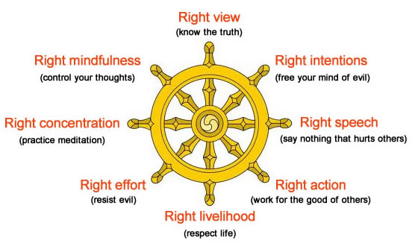

Slide 6
The First Path…
The first path is “Samyagdrishti”
Right views.
We have wrong views [mithyadrishti ] about the self and the world .
This wrong views is the root cause of our sufferings.

Slide 7
The second path…
The Second Path is “Samyaksankalp”.
Right resolve.
When we decide to lead a life according to right views i.e. Samyagdrishti.
We reform our life in the light of truth.
We give up worldliness , ill-feelings ,doing any harm to others.
This is right determination.

Slide 8
The third path…
The Third path is “Samyakvak”.
Right Speech.
Right Determination to guide and control our speech.
The Right Speech must be free from Lying , Slander , Unkind Words and Frivolous Talk.
The Right Speech consists of Truth and Love.

Slide 9
The fourth Path…
The Fourth Path is “Samyakkarmant”.
Right Conduct.
Right Determination should come into Right Action.
Right speech should convert into Good Conduct.
Right conduct includes “Panchsheel”.
Panchsheel are Five Vows i.e. No Killing, No Stealing, No Sensuality, No Lying and No Intoxication.

Slide 10
The fifth path…
The Fifth Path is “Samyagajiva”.
Right Livelihood.
One should earn his livelihood by honest means.
Means are as important as Goal.
Means and Goal both should be good.
To maintain life one should not take forbidden means.

Slide 11
The sixth path…
The Sixth Path is “Samyagvyayam”.
Right Effort.
We should constantly follow the Right Views, Right Resolve, Right Speech, Right Conduct and Right Livelihood.
Constantly following the above removes the deep rooted old evil ideas.
It prevents the arising of new evil thoughts.

Slide 12
The seventh path…
The Seventh Path is “Samyaksmriti”.
Right Mindfulness.
We should always remember what we have learnt.
We should remember Body as Body , Sensation as Sensation, Mind as Mind, Mental State as Mental State.
We are neither Body nor Sensation nor Mind nor Mental State.

Slide 13
The eighth path…
The Eighth Path is “Samyaksamadhi”.
Right Concentration.
The one who successfully follows the above seven paths reach the stage of Samadhi.
This stage makes one free from all Passions and Evil Thoughts.
This stage is “Cessation of Sufferings i.e. Nirvana”.
Nirvana is Absolute Knowledge and Eternal Bliss.

Slide 14
Thank you…..

