Slide 1
Durga Mahavidyalaya
Department of commerce
Dr vaseemuddin
Income Tax
Topic – Types of Allowances
भत्तो के प्रकार

Slide 2
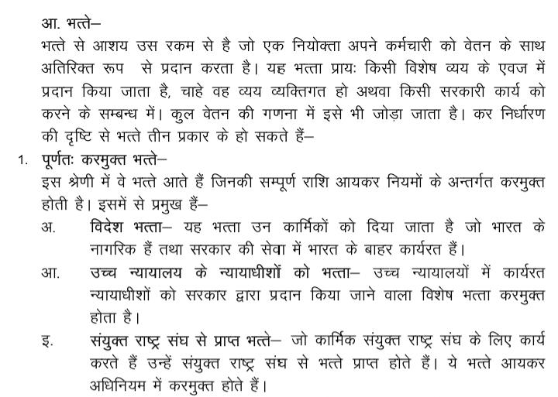

Slide 3
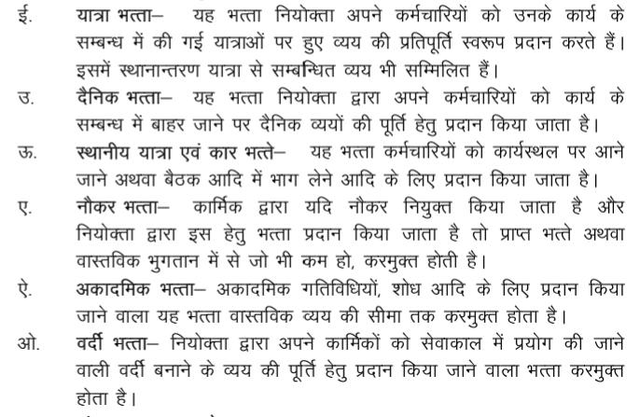

Slide 4
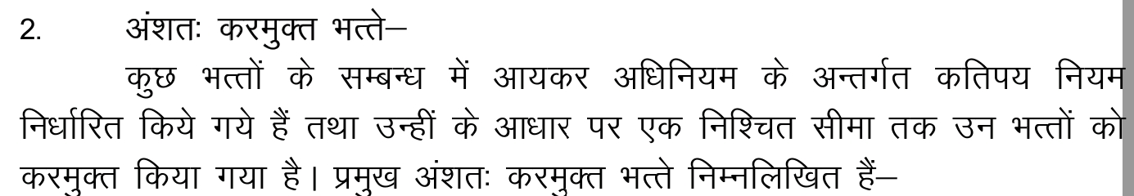
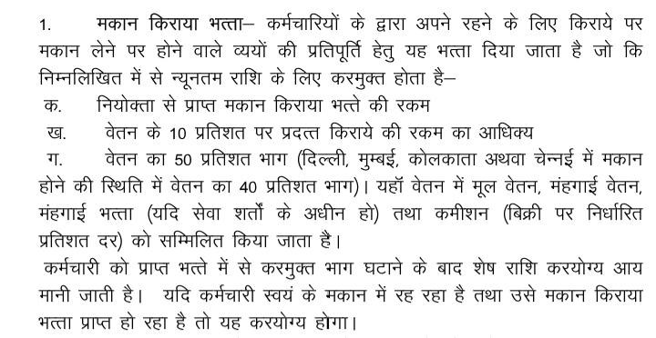

Slide 5
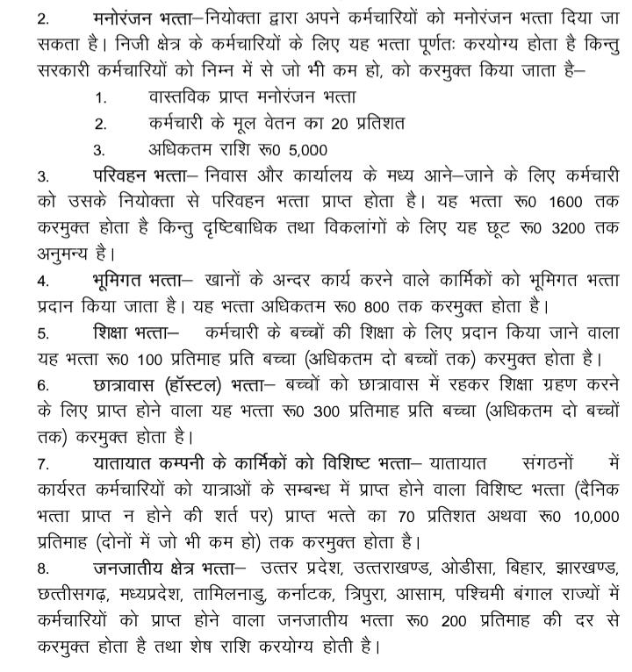

Slide 6
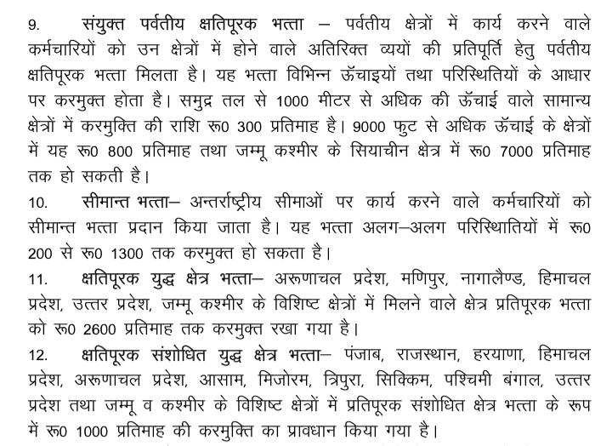

Slide 7
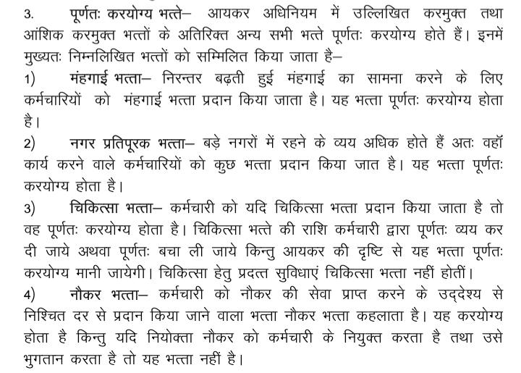

Slide 8
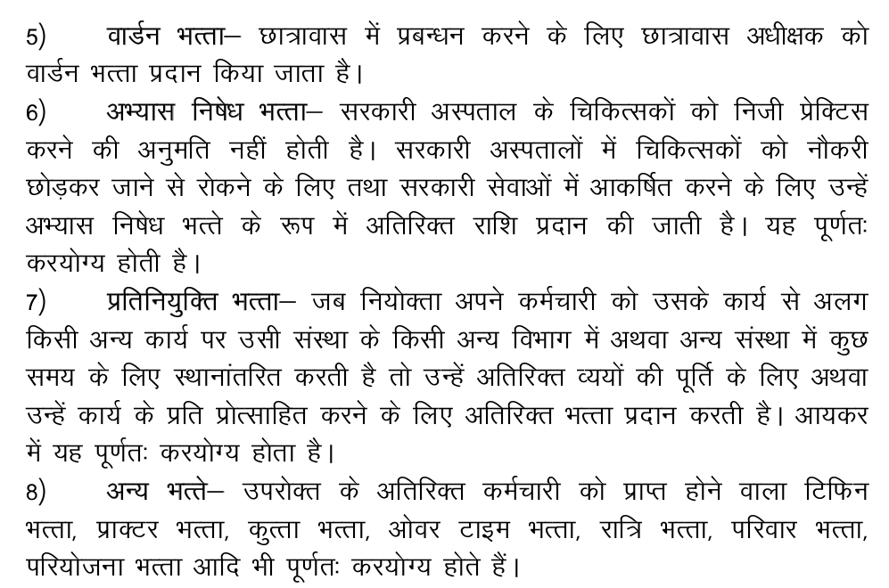

Slide 9
Thank you

